Slide 1

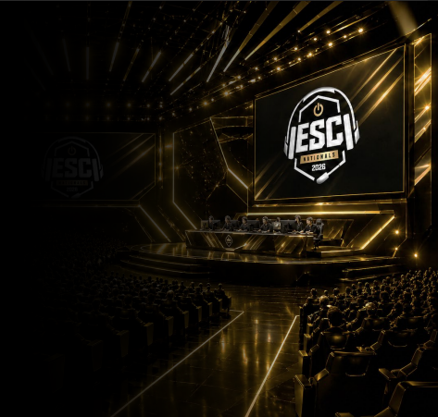
Morris Jackson II
Founder & CEO · ESC / Valhallan XP League | Building ESC - the national youth esports ecosystem
ABOUT
WHY THIS CONVERSATION
ESC is the trusted national infrastructure for youth gaming, combining physical arenas, structured coaching, league play, and a digital platform to give kids (ages 5-17), parents, and schools a safe, developmental pathway from first match to national championship. Operating brands Valhallan and XP League serve as the on-ramps into the ESC ecosystem.
Moderated guardrails for youth at scale
Family-first model, parents as partners, not bystanders
Gamification of development, not engagement tricks
Hybrid physical + digital infrastructure built for safety
50+ Arenas
20 States
1,700+ Paid Members
National Championship
Connect: morris@valhallan.com· esc.gg · valhallan.com · xpleague.com

