Slide 1
Identifying, Addressing, and Treating the Dual Epidemics of Hepatitis C Virus and Opioid Use Disorder
Beth A. Rutkowski, MPH
UCLA Integrated Substance Use and Addiction Programs | Pacific Southwest Addiction Technology Transfer Center |Region 9 Opioid Response Network
December 8, 2025
Notes:
This interactive webinar focuses on bridging the gap and integrating hepatitis C virus (HCV) and opioid use disorder treatment. It integrates evidence-based best practices, current treatment guidelines, and overdose prevention and other lifesaving safety approaches.
Focused Audience: clinicians, addiction specialists, nurses, counselors, social workers, and community health professionals.
Duration: 90 minutes (including discussion and Q&A)

Slide 2
Welcome!
The Nevada Opioid Center of Excellence (NOCE) is dedicated to developing and sharing evidence-based training and offering technical assistance to professionals and community members alike. Whether you’re a care provider or a concerned community member, NOCE provides resources to support those affected by opioid use.
Today’s presentation was made possible in whole or in part by the Nevada Department of Health and Human Services (DHHS) Director’s Office through the Fund for a Resilient Nevada, established in Nevada Revised Statutes 433.712 through 433.744. The opinions, findings, conclusions, and recommendations expressed in our courses are those of the author(s) and do not necessarily represent the official views of the Nevada Opioid Center of Excellence or its funders.

Slide 3
Disclosures
None of the presenters, planners, or others in control of content for this educational activity have relevant financial relationships to disclose with ineligible companies whose primary business is producing, marketing, selling, re-selling, or distributing healthcare products used by or on patients.

Slide 4
Acknowledgements
Nevada Opioid Center of Excellence (NOCE) Team
Sarah Rowan, MD, Denver Health
Bob Jope, LMHC, Jope Consulting Services
Opioid Response Network
HCV Current Initiative (ATTC Network)
4
Notes:
It takes a village – special thanks to all involved in developing the content you see here today.

Slide 5
Learning Objectives
Identify at least three (3) key aspects of the epidemiology of hepatitis C virus (HCV), including its transmission, prevalence, and high-risk populations.
1
Explain at least two (2) recent advances in HCV treatment, highlighting the differences and advantages of each treatment approach.
2
Describe at least two (2) benefits of integrating HCV testing and treatment into MAT and OTP care settings.
3
5
Notes:
Participants will also have access to up-to-date resources and guidelines for ongoing support and implementation.

Slide 6
Common Terms and Abbreviations
DAA – Direct Acting Antivirals
HCV – Hepatitis C Virus
OBOT – Office-Based Opioid Treatment
OTP – Opioid Treatment Program
OUD – Opioid Use Disorder
PWID – People Who Inject Drugs
PWUD – People Who Use Drugs
6

Slide 7
Polling Question #1
How often do you encounter patients with both opioid use disorder and hepatitis C?
A. Frequently
B. Occasionally
C. Rarely
D. Never
7
Notes:
Participant Poll #1 – experience with HCV and OUD.
This helps us to understand the experience in the Zoom room; there are no wrong answers.

Slide 8
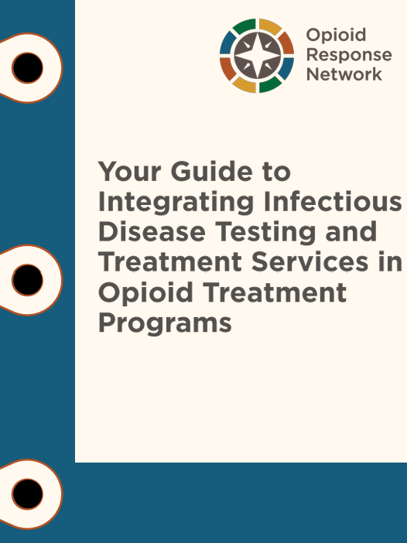
A Toolkit to Guide Your HCV Testing and Treatment Services
Your Guide to Integrating Infectious Disease Testing and Treatment Services in Opioid Treatment Programs is a continuation and expansion of work previously conducted by the Addiction Technology Transfer Center (ATTC) Network Coordinating Office (NCO), funded by SAMHSA.
An earlier version of this guide, Your Guide to Integrating HCV Services into Opioid Treatment Programs, was published in 2020.
8
Notes:
The opioid epidemic has resulted in significant increases in HIV, HCV, and syphilis among people who inject drugs. The intent of this Guide is to build the capacity of Opioid Treatment Programs (OTPs), with an emphasis on publicly funded OTPs, to integrate infectious disease prevention, screening, and treatment services. Integrating infectious disease services at OTPs has the potential to both (i) enhance prevention, screening, and treatment by addressing key gaps in patient care, and (ii) support patients’ recovery journeys by improving their overall well-being. This Guide provides insights, examples, and strategies to support OTPs in integrating infectious disease services into behavioral health programming.
Link to Toolkit: https://attcnetwork.org/wp-content/uploads/2024/08/FINAL-Integrating-Infectious-Disease-Services-into-OTPs-Guide-08.16.24.pdf.

Slide 9
Epidemiology and Intersection of HCV and OUD
Part one
Notes:
(15 minutes)
In Part One of the webinar, participants will learn about:
An overview of hepatitis C virus, transmission, progression, and public health impact.
Current epidemiologic trends, including the rise in HCV infections among people who inject drugs (PWID).
Regional variations (e.g., rural vs. urban).
Role of fentanyl and polysubstance use in increasing transmission risk.
Key References:
CDC. (2025). Viral Hepatitis Surveillance Report.
Schillie, S., et al. (2020). CDC Recommendations for Hepatitis C Screening among Adults – United States. MMWR 69(2), 1-17.

Slide 10
The Syndemic of Substance Use, HIV, HCV, and Syphilis
Syndemics occur when two or more diseases or health conditions cluster and interact within a population leading to an excess burden of disease. Syndemics arise when:
1. Two (or more) diseases or health conditions cluster and interact within a population.
2. Social and structural factors allow for diseases or health conditions to cluster; and
3. The clustering of disease or health conditions results in disease interaction, either biological or social or behavioral, leading to an excess burden of disease
**Refer to Handouts
10
Notes:
Substance use and overdose are part of a larger syndemic that includes HIV, HCV, and syphilis and disproportionately impacts people who use drugs. The visual on the next page highlights select examples of the ways in which infectious diseases like HCV, HIV, and syphilis interact with substance use. Hepatitis B, gonorrhea, and chlamydia also disproportionately impact people who use drugs.
Link to Toolkit: https://attcnetwork.org/wp-content/uploads/2024/08/FINAL-Integrating-Infectious-Disease-Services-into-OTPs-Guide-08.16.24.pdf.

Slide 11
What are Opioids?
Natural opioids, such as morphine, codeine, opium, and thebaine are made from the seed pods of the opium poppy plant. These natural substances are also known as opiates.
Semi-synthetic opioids, such as heroin and the pain relievers oxycodone, hydrocodone, and oxymorphone, are made in laboratories by chemically processing natural opioids.
Synthetic opioids, such as fentanyl are manufactured entirely in laboratories, with no natural ingredients.
11
Notes:
Opioids are a class of natural, semi-synthetic, and synthetic drugs that include both prescription medications and illegal drugs like heroin. Prescription medications such as oxycodone (OxyContin®), hydrocodone (Vicodin®), morphine, codeine, fentanyl, and others are mainly used for the treatment of pain. They can also help treat cough or diarrhea. However, like illegal opioids, prescription opioids can be addictive, particularly if they are misused. Opioids differ in their strength, or potency. For example, fentanyl is 50 to 100 times more potent than morphine. This means that even small doses of fentanyl can be fatal. Fentanyl can be even more dangerous when it is mixed with other drugs. This can happen without the knowledge of the person taking them.

Slide 12
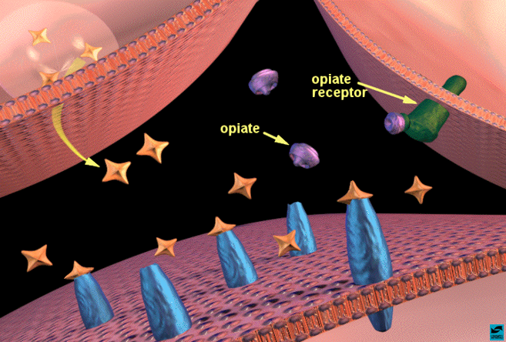
How Do Opioids Work?
Opioids bind to opioid receptors on certain nerve cells in the brain, the spinal cord, and throughout the body.
Opioids help control pain, regulate breathing (respiration), and help with stress responses.
Additionally, opioid receptors are found in brain regions collectively called the reward system. In response to natural rewards, such as food and social interactions, they trigger brain processes that make us feel good and make us want to repeat the healthy behaviors that help us survive.
12
Notes:
Opioids are a class of natural, semi-synthetic, and synthetic drugs that include both prescription medications and illegal drugs like heroin. Prescription medications such as oxycodone (OxyContin®), hydrocodone (Vicodin®), morphine, codeine, fentanyl, and others are mainly used for the treatment of pain. They can also help treat cough or diarrhea. However, like illegal opioids, prescription opioids can be addictive, particularly if they are misused. Opioids differ in their strength, or potency. For example, fentanyl is 50 to 100 times more potent than morphine. This means that even small doses of fentanyl can be fatal. Fentanyl can be even more dangerous when it is mixed with other drugs. This can happen without the knowledge of the person taking them.
Opioids look like chemicals in your brain and body that attach to tiny parts on nerve cells called opioid receptors. Scientists have found three types of opioid receptors: mu, delta, and kappa (named after letters in the Greek alphabet). Each of these receptors plays a different role. For example, mu receptors are responsible for opioids’ pleasurable effects and their ability to relieve pain.
Opioids act on many places in the brain and nervous system, including:
The limbic system, which controls emotions. Here, opioids can create feelings of pleasure, relaxation, and contentment.
The brainstem, which controls things your body does automatically, like breathing. Here, opioids can slow breathing, stop coughing, and reduce feelings of pain.
The spinal cord, which receives sensations from the body before sending them to the brain. Here too, opioids decrease feelings of pain, even after serious injuries
REFERENCE:
National Institute on Drug Abuse; National Institutes of Health; U.S. Department of Health and Human Services.

Slide 13
Acute Effects of Opioids
Euphoria
Pain relief
Suppresses cough reflex
Histamine release
Warm flushing of the skin
Dry mouth
Drowsiness and lethargy
Sense of well-being
Respiratory depression
Sedation
Pupil constriction
Slurred speech
Impaired attention/memory
Constipation, urinary retention
Nausea
Confusion, delirium
Seizures
Slowed heart rate
13
Notes:
People who use heroin report feeling a "rush" (a surge of pleasure, or euphoria). However, there are other common effects, including:
dry mouth
warm flushing of the skin
heavy feeling in the arms and legs
nausea and vomiting
severe itching
clouded mental functioning
going "on the nod," a back-and-forth state of being conscious and semiconscious
Heroin often contains additives, such as sugar, starch, or powdered milk, that can clog blood vessels leading to the lungs, liver, kidneys, or brain, causing permanent damage. Also, sharing drug injection equipment and having impaired judgment from drug use can increase the risk of contracting infectious diseases such as HIV and hepatitis (see "Injection Drug Use, HIV, and Hepatitis").
REFERENCE:
National Institute on Drug Abuse; National Institutes of Health; U.S. Department of Health and Human Services. Available at:
https://www.drugabuse.gov/publications/drugfacts/heroin.

Slide 14
Long-Term Effects of Opioids
Fatal overdose
Infectious diseases
Infection of heart lining and valves
Pulmonary complications and pneumonia
Respiratory problems
Liver disease
Constipation
Pregnancy-related complications
Collapsed veins, abscesses, and cellulitis
14
Notes:
People who inject drugs such as heroin are at high risk of contracting the HIV and hepatitis C (HCV) virus. These diseases are transmitted through contact with blood or other bodily fluids, which can occur when sharing needles or other injection drug use equipment. HCV is the most common blood born infection in the United States. HIV (and less often HCV) can also be contracted during unprotected sex, which drug use makes more likely.
REFERENCE:
National Institute on Drug Abuse; National Institutes of Health; U.S. Department of Health and Human Services.
https://www.drugabuse.gov/publications/drugfacts/heroin

Slide 15
Opioid Withdrawal (1)
Intensity varies with level and chronicity of use
Cessation of opioids causes a rebound in functions depressed by use
First signs occur shortly before next scheduled dose
For short-acting opioids (e.g., heroin) peak of withdrawal occurs 36-72 hours after last dose
Acute symptoms subside over 3 to 7 days
Ongoing symptoms may linger for weeks or months
Symptoms include dysphoric mood, nausea or vomiting, diarrhea, tearing or runny nose, dilated pupils, muscle aches, goosebumps, sweating, yawning, fever, and insomnia
15
Notes:
Continued use of the drug causes issues, such as health problems and failure to meet responsibilities at work, school, or home. An SUD can range from mild to severe, the most severe form being addiction.
Those who are addicted to heroin and stop using the drug abruptly may have severe withdrawal. Withdrawal symptoms—which can begin as early as a few hours after the drug was last taken—include:
restlessness
severe muscle and bone pain
sleep problems
diarrhea and vomiting
cold flashes with goose bumps ("cold turkey")
uncontrollable leg movements ("kicking the habit")
severe heroin cravings
Once the body becomes accustomed to an opioid being present, it may react if the opioid is removed. The intensity of the withdrawal symptoms will depend on the level of use (dose and type of opioid) and the frequency and duration of use (chronicity). Withdrawal symptoms are basically a rebound effect; those functions that have been depressed or altered by the opioid suddenly emerge again. Withdrawal symptoms are often the opposite of symptoms seen when actively using the opioid (e.g., people get constipated when taking opioids and have diarrhea when withdrawing). The length of withdrawal depends upon the half-life of the opioid. Opioids with short half-lives (e.g., heroin) have acute withdrawal symptoms that peak at 3-4 days and then subside by days 3-7. Opioids with longer half-lives have longer acute withdrawal periods. Regardless of the length of the acute withdrawal, there are protracted withdrawal symptoms (e.g., aches and pains, general malaise) that persist for weeks or months after use ceases. Protracted withdrawal symptoms are less severe than the acute symptoms, but are still experienced as extremely disruptive and uncomfortable.
REFERENCE: Li, W., Li, Q., Zhu, J., et al. (2013). White matter impairment in chronic heroin dependence: a quantitative DTI study. Brain Res, 1531, 58-64. doi:10.1016/j.brainres.2013.07.036.
Liu, J., Qin, W., Yuan, K., et al. (2011). Interaction between dysfunctional connectivity at rest and heroin cues-induced brain responses in male abstinent heroin-dependent individuals. PloS One, 6(10), e23098. doi:10.1371/journal.pone.0023098.
Qiu, Y., Jiang, G., Su, H., et al. (2013). Progressive white matter microstructure damage in male chronic heroin dependent individuals: a DTI and TBSS study. PloS One, 8(5), e63212. doi:10.1371/journal.pone.0063212.
National Institute on Drug Abuse; National Institutes of Health; U.S. Department of Health and Human Services. Available at:
https://www.drugabuse.gov/publications/drugfacts/heroin.

Slide 16
Opioid Withdrawal (2)
All opioids produce similar withdrawal symptoms when stopped abruptly
Severity varies with the amount and duration of use
Timing of withdrawal symptoms depends on the type of opioid used
opioids used | onset of withdrawal | symptoms peak | duration of withdrawal
Short-acting opioids (e.g., heroin, oxycodone) | 6-12 hours | 36-72 hours | about 5 days
Long-acting opioids (e.g., methadone) | 36-48 hours | ~ 72 hours | up to 3 weeks
16
Notes:
Opioid use disorder is a complex, chronic, and treatable medical condition. A person who has been diagnosed with opioid use disorder or another substance use disorder has a pattern of two or more symptoms and behaviors related to their substance use. The Diagnostic and Statistical Manual of Mental Disorders, Fifth Edition (DSM-5)—a reference text professionals use to diagnose substance use disorders—lists these as:
Consuming the drug in larger amounts or for longer than intended.
Persistently wanting to cut down or regulate drug use.
Spending a great deal of time obtaining, using, or recovering from the effects of the drug.
Experiencing a strong desire to use the drug (craving).
Failing to fulfill major obligations at work, school, or home because of drug use.
Continuing drug use even if it causes significant social or interpersonal problems.
Reducing or stopping other activities because of drug use.
Repeatedly using the drug in situations when it is unsafe.
Continuing drug use even when knowing that it causes physical or psychological problems.
Developing tolerance.
Experiencing withdrawal symptoms when stopping drug use.
In 2023, about 5.7 million people in the United States had opioid use disorder.
REFERENCE:
Shah M, & Huecker, M. R. (2023). Opioid Withdrawal. [Updated 2023 Jul 21]. In: StatPearls [Internet]. Treasure Island (FL): StatPearls Publishing; 2025 Jan-. Available from: https://www.ncbi.nlm.nih.gov/books/NBK526012/

Slide 17
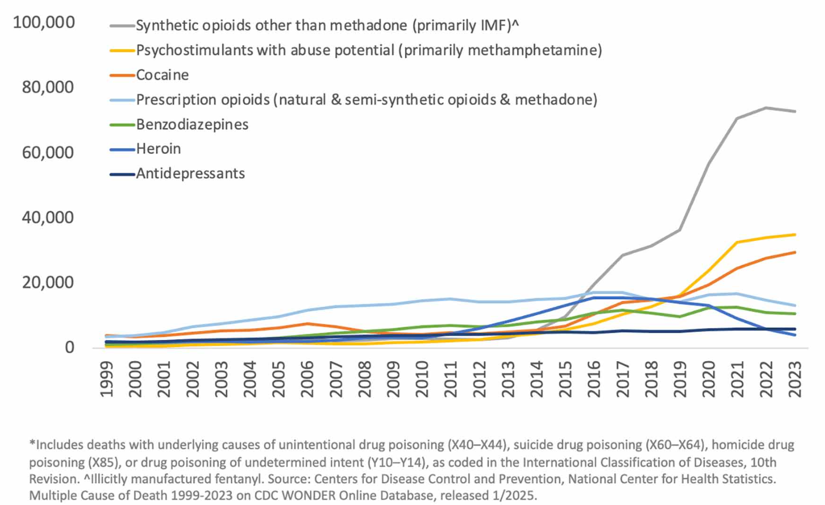
Drivers of Drug Poisoning Deaths Evolve from Opioids to Stimulants
17
Notes:
TRAINER SCRIPT:
This next slide shows how the drivers of fatal drug poisonings have changed over time.
In the early 2000s, most overdose deaths were linked to prescription opioids — medications like oxycodone and hydrocodone. These were the drugs that launched what’s often called the first wave of the opioid crisis.
Then, as access to those medications decreased, we saw people turning to heroin, marking the second wave.
Beginning around 2014, the curve that changes everything is the gray one — synthetic opioids other than methadone, which primarily means illicitly manufactured fentanyl.
Fentanyl deaths surged almost vertically, reaching unprecedented levels by 2019and beyond. This marks the third and most deadly wave of the epidemic.
You will also notice that psychostimulants and cocaine are rising along with fentanyl. We’re now in what experts describe as a fourth wave — a polysubstance crisis. People aren’t just using opioids; they’re using combinations of stimulants and fentanyl, often unknowingly, and these mixtures drastically increase the risk of fatal overdose.
So while the overall picture started with prescription opioids, it’s evolved into something far more complex. The drug landscape has shifted — from prescription misuse to a highly toxic, unpredictable illicit supply.
REFERENCE:
NIDA. 2024, August 21. US Overdose Deaths: Select Drugs or Drug Categories, 1999-2023. https://nida.nih.gov/research-topics/trends-statistics/overdose-death-rates#Fig2 on 2025, November 6.

Slide 18
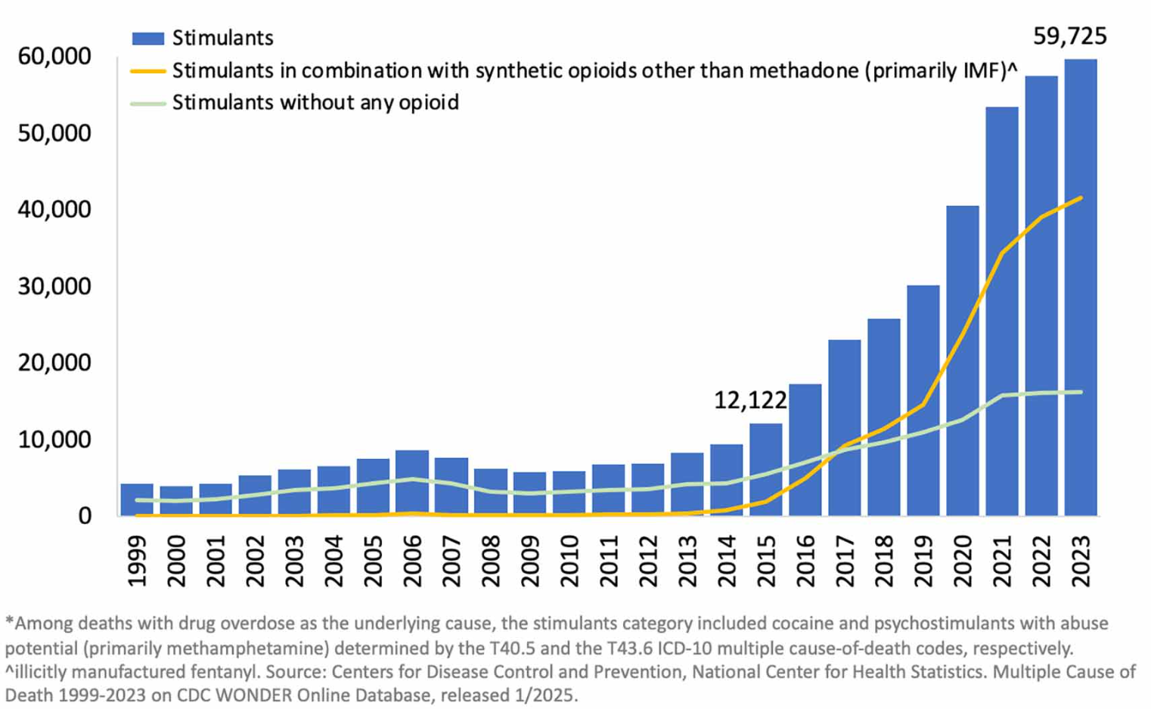
Drug Poisoning Deaths Involving Fentanyl and Stimulants, 1999-2023
18
Notes:
Drug overdose deaths rose from 12,122 in 2015 to 59,725 in 2023. Nearly 70% of stimulant involved overdose deaths in 2023 also involved IMF (Source: CDC WONDER).
REFERENCE:
Centers for Disease Control and Prevention. (2025). [Webpage]. Understanding the Opioid Overdose Epidemic. Accessed November 13, 2025 from: https://www.cdc.gov/overdose-prevention/about/understanding-the-opioid-overdose-epidemic.html.

Slide 19
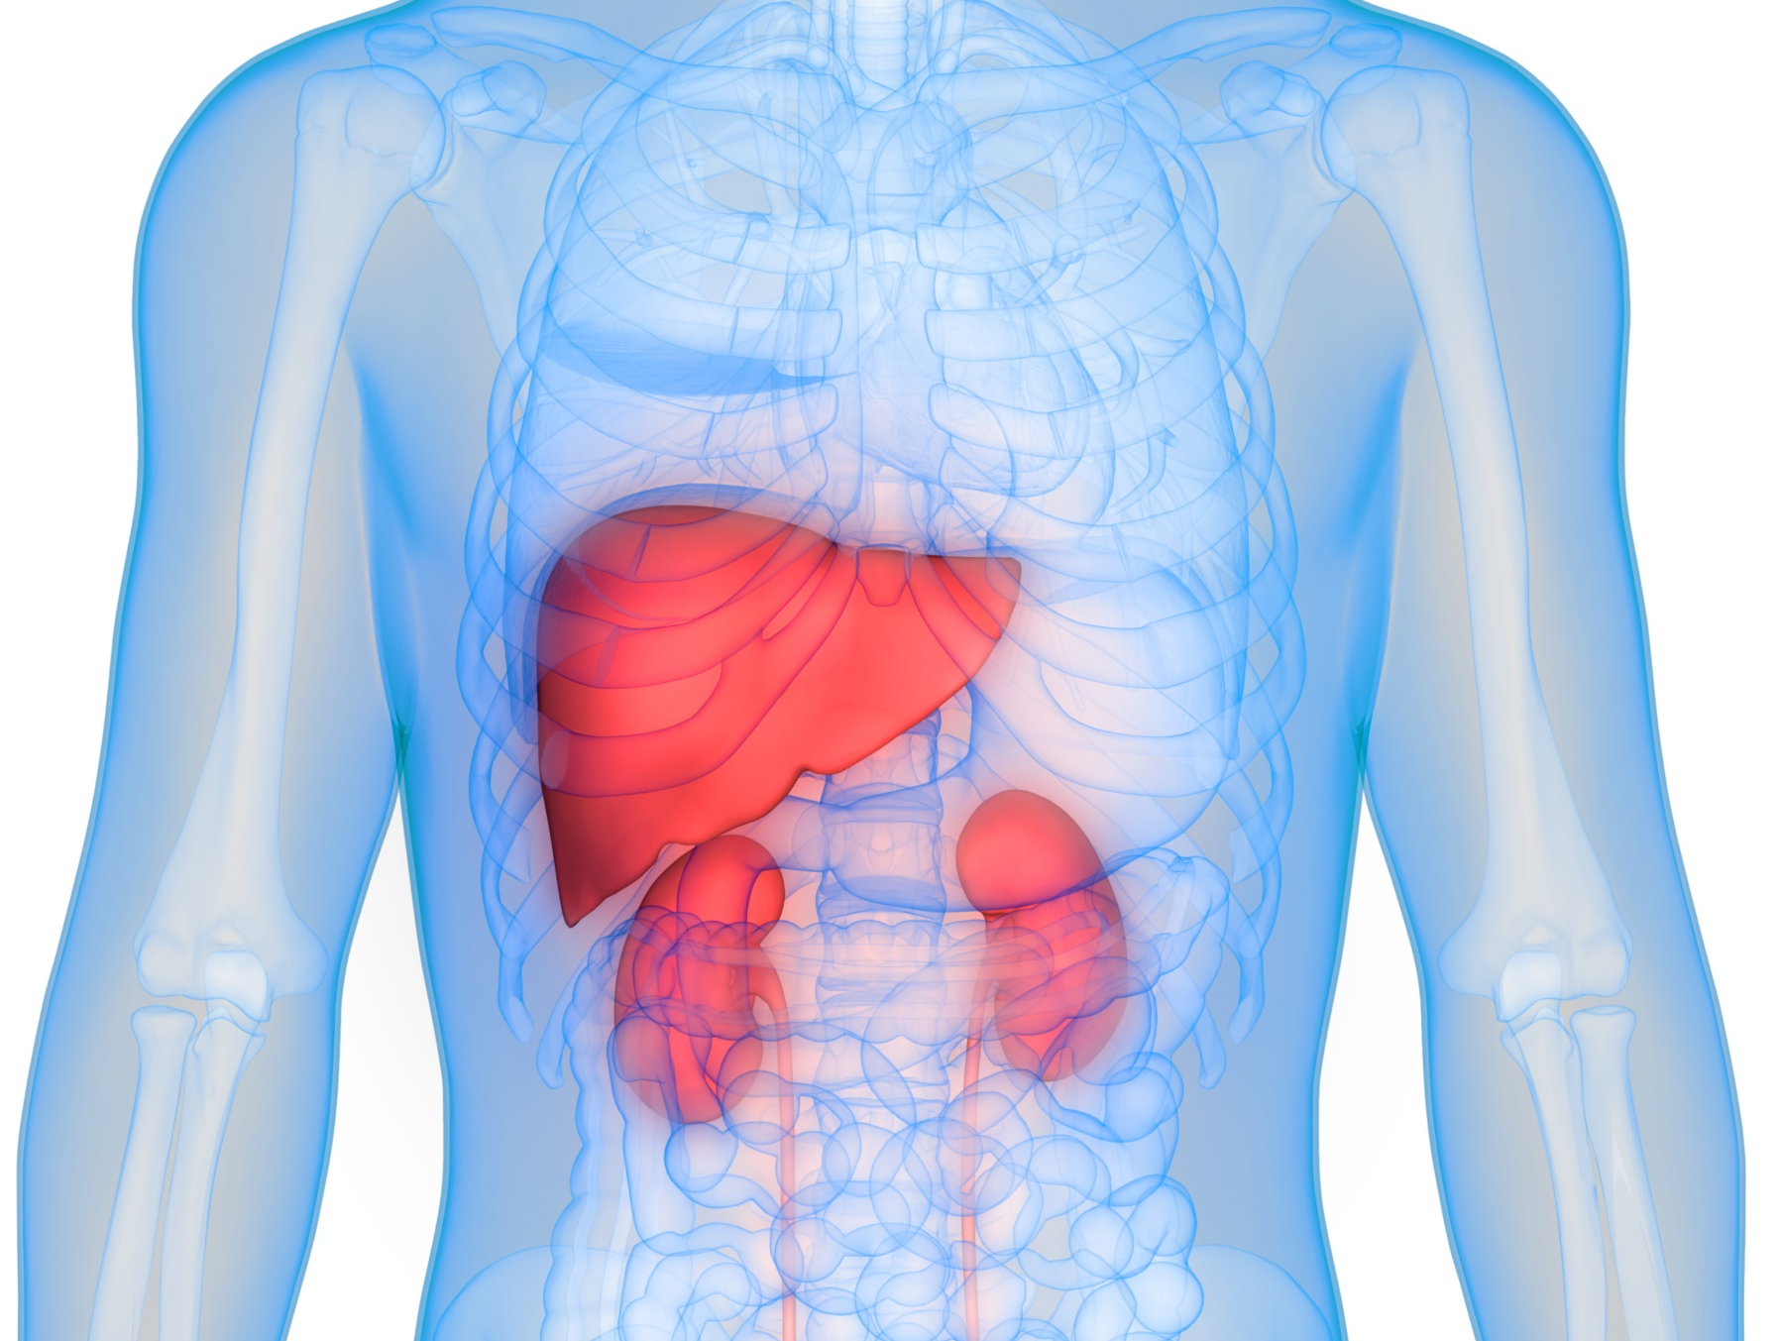
Hepatitis C Virus (HCV) – An Overview
What is HCV?
Highly infectious bloodborne virus that causes liver inflammation
Starts out with minor or no symptoms
Some clear it on their own (acute infection)
Can become chronic (55-85%)
19
Notes:
Hepatitis C is a liver disease caused by the hepatitis C virus (HCV). Many people with hepatitis C do not look or feel sick so might not know they have the virus. Left untreated, hepatitis C can lead to serious liver problems, like scarring and cancer. Hepatitis C is one of the most common types of viral hepatitis in the U.S.
HCV is 4 times more prevalent than HIV and hepatitis B.
REFERENCE:
Centers for Disease Control and Prevention. (2025). [Webpage]. Hepatitis C Basics. Accessed November 12, 2025, from: https://www.cdc.gov/hepatitis-c/about/?CDC_AAref_Val=https://www.cdc.gov/hepatitis/hcv/HepatitisCOverview.htm.

Slide 20
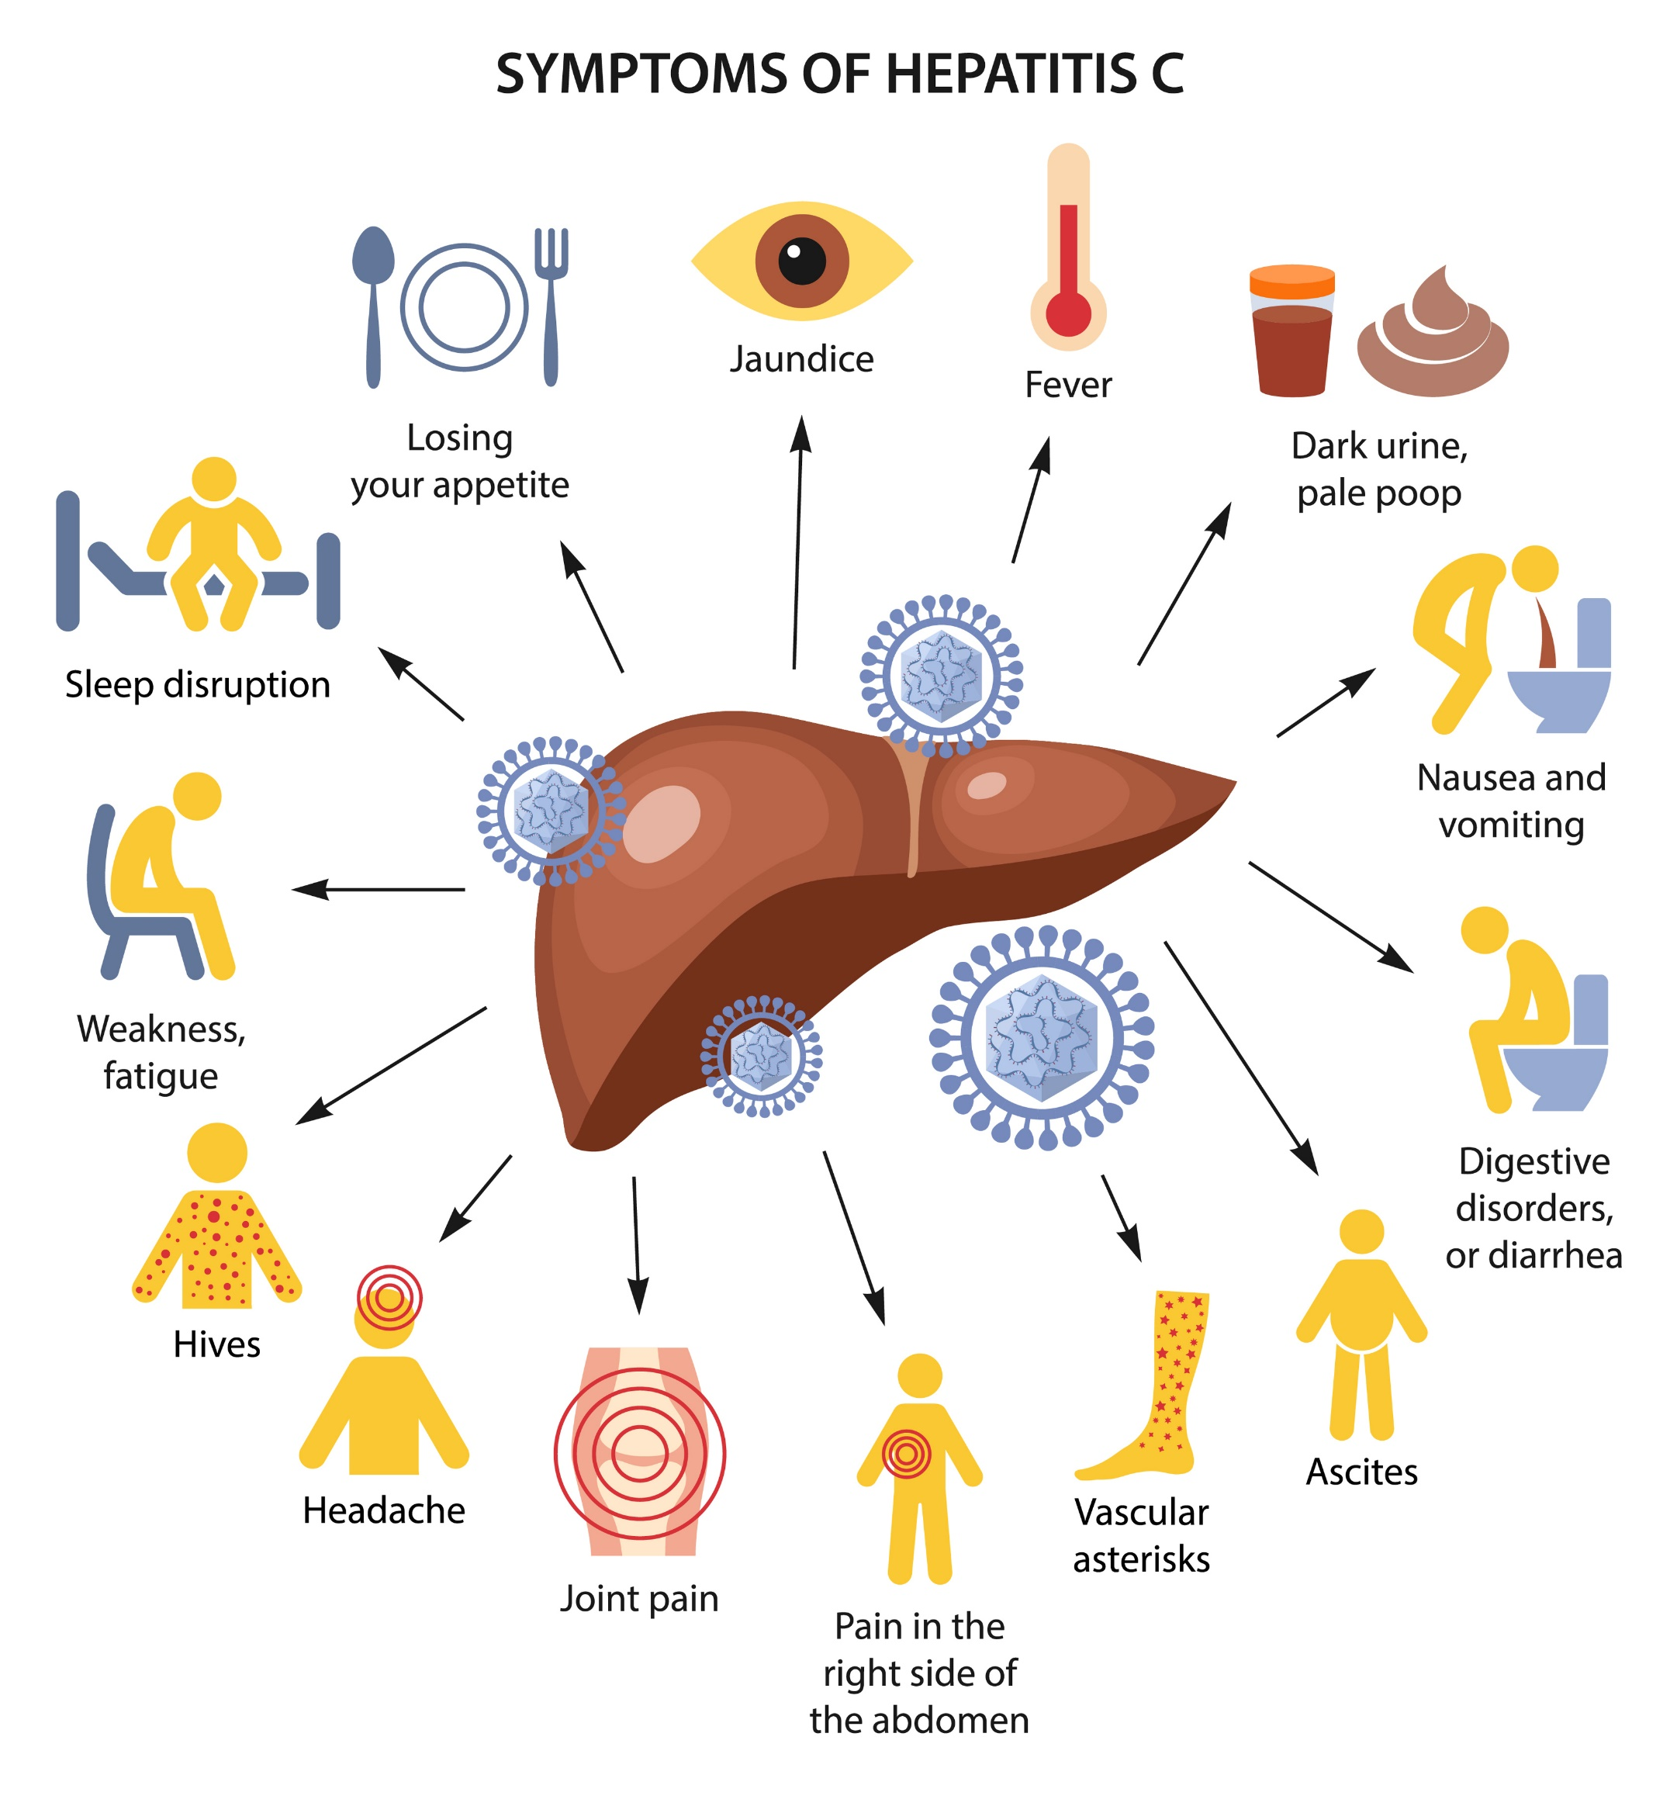
Hepatitis C Virus (HCV) – An Overview (2)
Common symptoms of infection:
Fever
Fatigue
Loss of appetite
Nausea, vomiting
Abdominal pain
Abdominal swelling
Pale stool
Dark urine
Jaundice
Can be life-threatening; main causes of death due to HCV infection:
Cirrhosis
Primary liver cancer
20
Notes:
Symptomatic acute HCV infection is uncommon; if it occurs, most people do not have symptoms in the first weeks after infection. It can take between two weeks and six months to have symptoms. When symptoms do appear, they may include: fever, feeling very tired, loss of appetite, nausea and vomiting, abdominal pain, dark urine, pale feces, joint pain, and jaundice.
REFERENCE:
World Health Organization. (2025). [Webpage]. Hepatitis C. Accessed November 12, 2025, from: https://www.who.int/news-room/fact-sheets/detail/hepatitis-c.

Slide 21

Hepatitis C Virus (HCV) – An Overview (3)
An estimated 50 million people have chronic HCV infection globally
1 million new cases per year
Rates are rising in the 20-39 year-old age group
The only strain that can be CURED!
Effective vaccines are available for Hep A and B, but not for C
21
Notes:
REFERENCE:
World Health Organization. (2025). [Webpage]. Hepatitis C. Accessed November 12, 2025, from: https://www.who.int/news-room/fact-sheets/detail/hepatitis-c.

Slide 22
Risk Factors for HCV Exposure
Injection drug use is the most common method of exposure
43% of new cases in 2023 were correlated with injection drug use (CDC, 2025)
50% of people who inject drugs have been exposed globally
Interfamilial exposure (~6%)
Rates have gone up since 2017
Sexual activity (1%)
far more common with HBV
Healthcare exposure
Accidental needle sticks, PPE failures
Very rare, data is not great but estimated <2%
22
Notes:
During 2023, rates of acute hepatitis C were highest among males, persons aged 30–39 years, non-Hispanic American Indian/Alaska Native (AI/AN) persons, and those living in the Eastern and Southeastern states. Among cases with risk information reported, the most common risk factor was injection drug use.
REFERENCE:
Centers for Disease Control and Prevention. (2024). National Notifiable Diseases Surveillance System. Accessed November 13, 2025, from: https://www.cdc.gov/hepatitis-surveillance-2022/hepatitis-c/table-3-3.html.

Slide 23
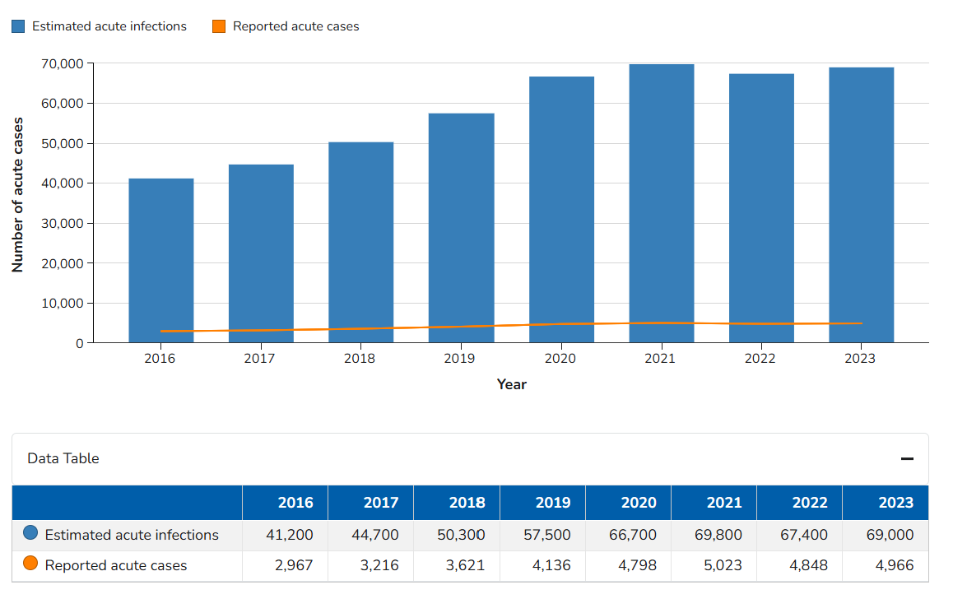
Number of Reported Cases and Estimated Infections of Acute Hepatitis C – US, 2016-2023
23
Notes:
After over a decade of consecutive annual increases in acute hepatitis C, the number of acute hepatitis C cases has remained relatively stable since 2021. This stabilization was observed despite a change to the acute hepatitis C case definition in 2020, which was designed to improve sensitivity in identifying acute hepatitis C cases. In 2023, there were 4,966 new cases of acute hepatitis C reported, and 69,000 estimated acute HCV infections after adjusting for case under ascertainment and underreporting.
There were 101,525 cases of newly reported chronic hepatitis C during 2023, and 11,194 hepatitis C-related deaths reported during 2023.
The Viral Hepatitis Surveillance Report – United States, 2023 is published by the Division of Viral Hepatitis, National Center for HIV, Viral Hepatitis, STD, and TB Prevention, Centers for Disease Control and Prevention (CDC), US Department of Health and Human Services, Atlanta, Georgia.
Data are presented for cases of viral hepatitis from January 1, 2023–December 31, 2023, and prior years for comparison. All material contained in this report is in the public domain and may be used and reprinted without special permission; however, citing this report is appreciated.
REFERENCE:
Centers for Disease Control and Prevention. Viral Hepatitis Surveillance Report – United States, 2023. https://www.cdc.gov/hepatitis-surveillance-2023/about/index.html Published April 2025. Accessed November 13, 2025.

Slide 24
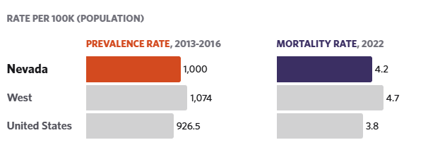
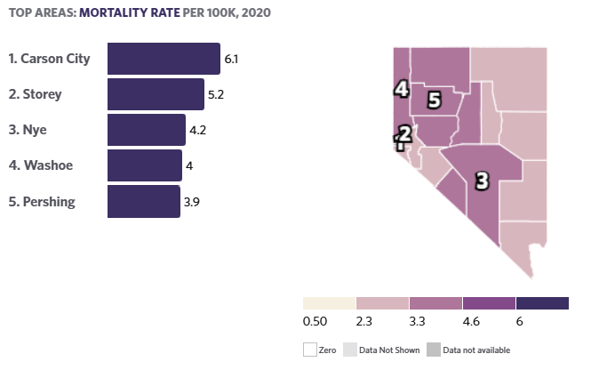
Hepatitis C in Nevada
24
Notes:
Additional data can be found here: https://map.hepvu.org/hepc-prevalence/state/case/sex_f/none/usa?geoContext=NV
Estimated rate of people living with Hepatitis C (per 100,000 population) = 1,000
Estimated number of people living with Hepatitis C = 21,900
Less than 50 years old = 5,100
50 to 74 years old = 16,300
75+ = 500
Male = 15,500
Female = 6,400

Slide 25
Acute* HCV Infection
Average time of development of HCV antibodies when first infected is about 6-8 weeks and up to six months in some cases
15%-25% spontaneously clear HCV without treatment in 3-4 months, most without symptoms
*Acute phase: within the first six months after acquiring infection
25
Notes:
Slide courtesy of Bob Jope, LMHC
Acute hepatitis C occurs within the first 6 months after someone is exposed to HCV. Hepatitis C can be a short-term illness, but for most people, acute infection leads to chronic infection.
REFERENCES:
Jope, B. (2025). Understanding Hepatitis C for Human Service Professionals. TA Session presented on behalf of the ATTC of New England. Available at: https://attcnetwork.org/wp-content/uploads/2025/08/Understanding-Hepatitis-C-for-Human-Service-Professionals.pdf.
Centers for Disease Control and Prevention. (2025). [Webpage]. Clinical Overview of Hepatitis C. Accessed November 13, 2025, from: https://www.cdc.gov/hepatitis-c/hcp/clinical-overview/index.html.

Slide 26
Chronic* HCV Infection
75-85% develop chronic infection and may remain stable for years
20%-30% develop cirrhosis and serious illness within 20 years if untreated
20%-37% will die because of liver failure or liver cancer due to untreated HCV disease
*Chronic phase: infected more than six months after acquiring infection
26
Notes:
Slide courtesy of Bob Jope, LMHC
Chronic hepatitis C can be a lifelong infection if left untreated. More than half of people who become infected with HCV will develop chronic infection. Chronic hepatitis C can cause serious health problems, including liver damage, cirrhosis (scarring of the liver), liver cancer, and even death.
REFERENCES:
Jope, B. (2025). Understanding Hepatitis C for Human Service Professionals. TA Session presented on behalf of the ATTC of New England. Available at: https://attcnetwork.org/wp-content/uploads/2025/08/Understanding-Hepatitis-C-for-Human-Service-Professionals.pdf.
Centers for Disease Control and Prevention. (2025). [Webpage]. Clinical Overview of Hepatitis C. Accessed November 13, 2025, from: https://www.cdc.gov/hepatitis-c/hcp/clinical-overview/index.html.

Slide 27
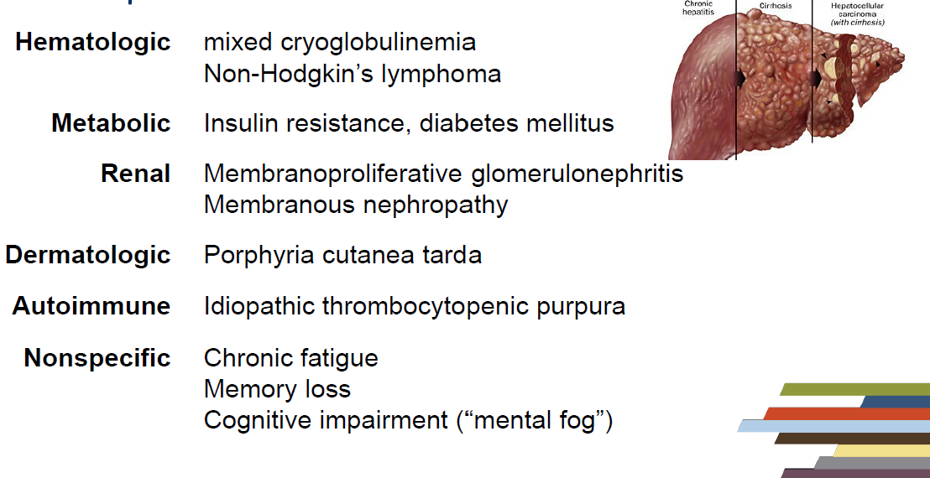
Chronic HCV Infection “Extrahepatic” Manifestations
27
Notes:
Slide courtesy of Bob Jope, LMHC
Among all viruses, hepatotropic and nonhepatotropic, HCV is recognized as the virus most often associated with extrahepatic manifestations. Although a large proportion of patients are asymptomatic, up to two thirds present with such manifestations. Unequivocal data support a causal relationship between chronic HCV infection and some of these disorders, including cryoglobulinemic vasculitis, lymphoma, cardiovascular diseases, insulin resistance, and type 2 diabetes, all of which can substantially affect morbidity, mortality, and quality of life.
REFERENCES:
Jope, B. (2025). Understanding Hepatitis C for Human Service Professionals. TA Session presented on behalf of the ATTC of New England. Available at: https://attcnetwork.org/wp-content/uploads/2025/08/Understanding-Hepatitis-C-for-Human-Service-Professionals.pdf.
Cacoub, P., & Saadoun, D. (2021). Extrahepatic manifestations of chronic HCV infection. New England Journal of Medicine, 384, 1038-1052.

Slide 28
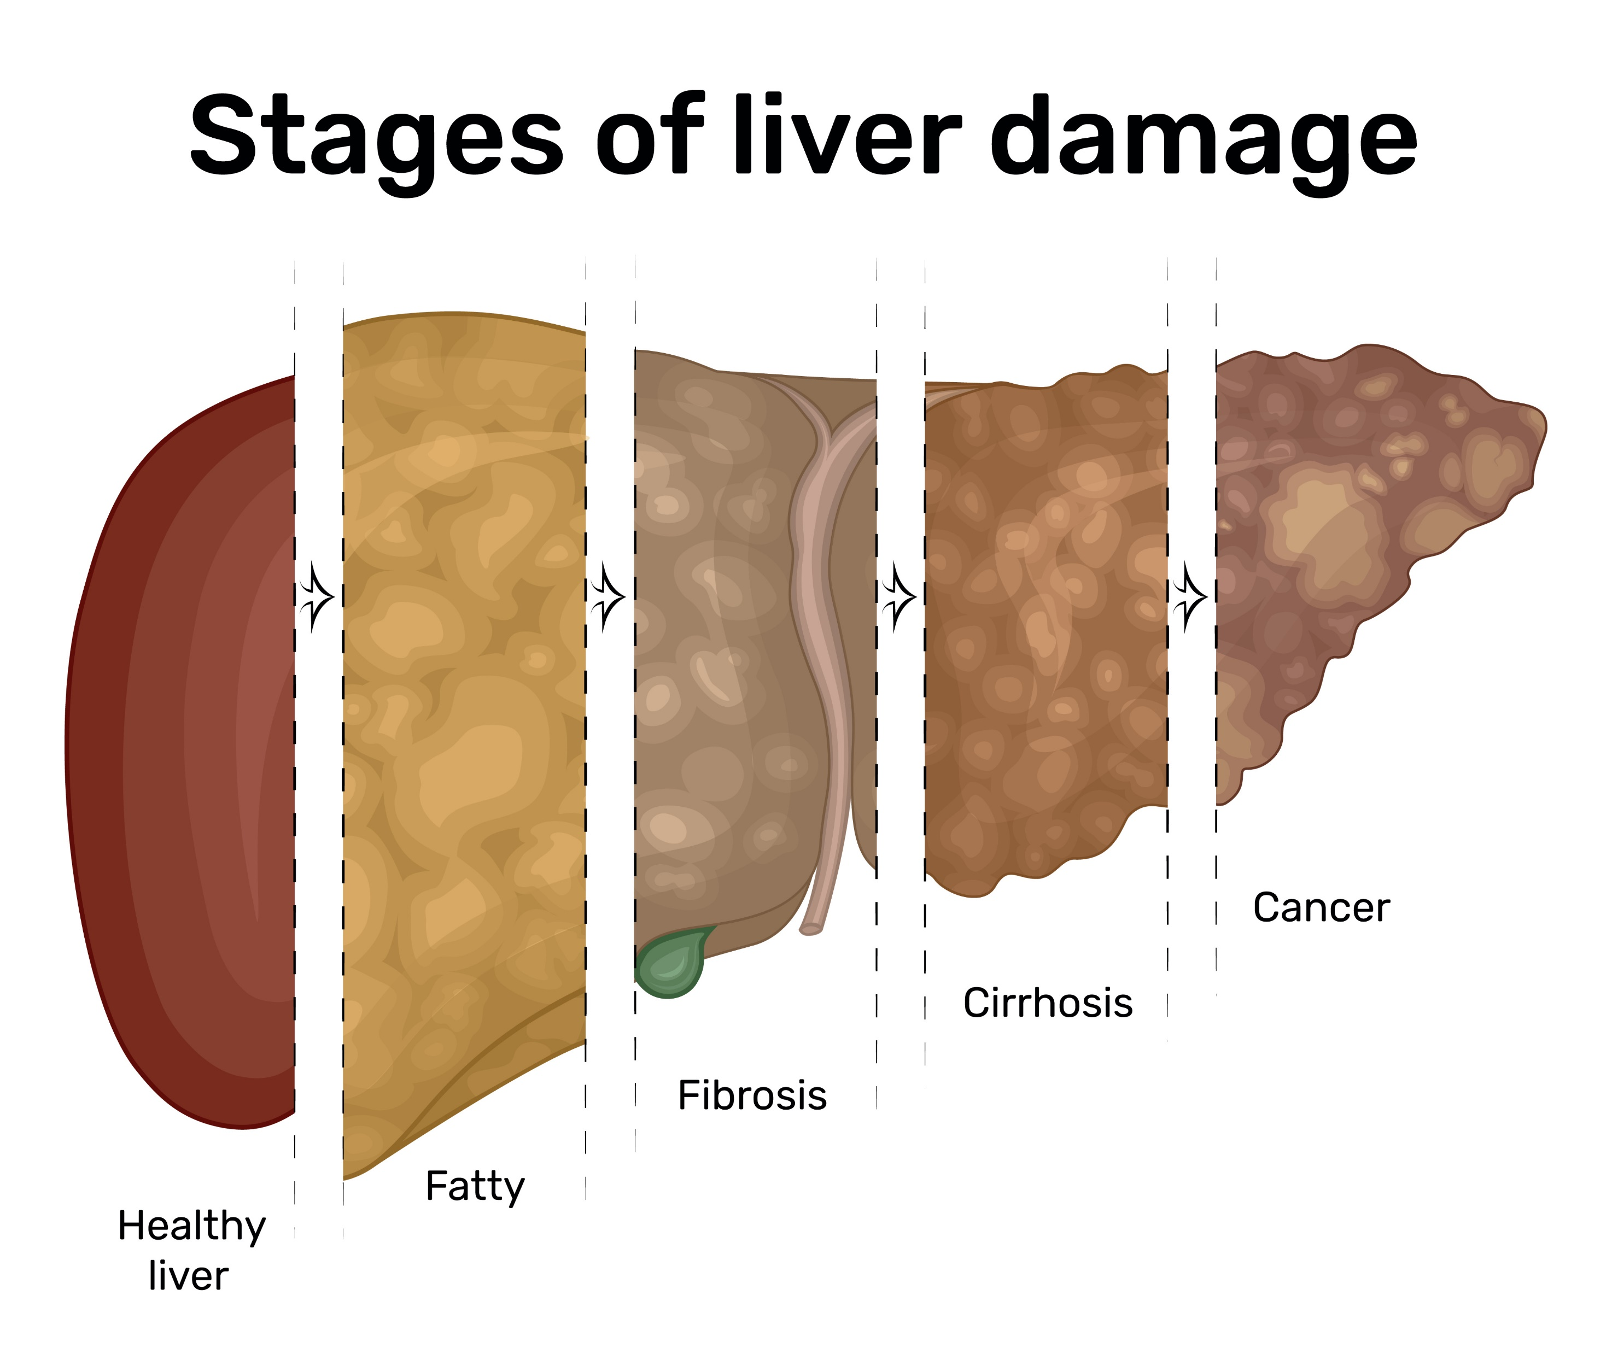
HCV-Associated Liver Damage
Early testing and intervention can prevent serious, irreversible liver damage
This is complicated by many people not experiencing symptoms until later stages
Liver damage can be measured in stages, ultimately leading to liver cancer
Inflammation triggers collagen production and over time this hardens and forms scar tissue in the liver (fibrosis)
Fibrosis impairs liver functioning by restricting blood flow
Fibrosis can be reversed up until cirrhosis develops
28
Notes:
When someone has liver disease, their liver enters into a very dangerous cycle. Persistent inflammation, or hepatitis, sends nonstop signals to repair cells to continue depositing collagen. The extra collagen stiffens around the tissue like it is supposed to in the healthy liver; but, instead of a signal being released to stop the inflammation and discard the extra collagen, the inflammation continues, and even more collagen is deposited, leading to more stiffening. This is how fibrosis develops.
Scarring = fibrosis
F4 = stage 4 fibrosis or cirrhosis.
Early testing is best as this can prevent serious liver damage. Cirrhosis is irreversible.
As the liver continues to experience inflammation, collagen is produced in an attempt to repair the tissue. Over time, this collagen hardens and forms scar tissue along with other proteins. This scar tissue forms between cells and over the liver, and as inflammation continues, the cycle of repair continues and the scar tissue takes over more and more of the liver tissue. This scar tissue is called fibrosis, and can be measured based on how widespread it has become.
The fibrosis restricts bloodflow and makes it harder for the liver to function properly. Over time, the function can become so impaired that cirrhosis is diagnosed. Cancer is the next stage, but not all people with cirrhosis will go on to develop cancer.
Again, cirrhosis and primary liver cancer are the main causes of HCV related deaths.
REFERENCE: American Liver Foundation. (2025). [Webpage] Fibrosis (Scarring). Accessed November 13, 2025, from: https://liverfoundation.org/about-your-liver/how-liver-diseases-progress/fibrosis-scarring/.

Slide 29
Screening, Diagnosis, and Linkage to Care
Part two
Notes:
(15 minutes)
In Part Two of the webinar, participants will learn about:
Universal screening recommendations (CDC, USPSTF).
Testing algorithm: HCV antibody → RNA confirmation → genotype determination.
Strategies for implementing screening in OUD settings (e.g., MAT clinics/OTPs).
Approaches to linkage to care: peer navigation, integrated care pathways.
Key References:
American Association for the Study of Liver Diseases (AASLD) & Infectious Diseases Society of America (IDSA). (2023). HCV Guidance: Recommendations for Testing, Managing, and Treating Hepatitis C.
Schillie, S., et al. (2020). CDC Recommendations for Hepatitis C Screening among Adults – United States. MMWR 69(2), 1-17.

Slide 30
Polling Question #2
Does your organization offer HCV testing, services, and/or treatment?
A. Testing only
B. Miscellaneous services
C. Treatment
D. Yes – all of the above
E. Unsure
F. No
30

Slide 31
Key Points for Clinical Screening and Diagnosis for HCV
CDC recommends universal hepatitis C screening for all adults 18 and older and all pregnant women during each pregnancy.
CDC recommends testing people in certain high-risk groups more frequently.
Testing, diagnosis, and timely treatment can prevent hepatitis C complications and interrupt transmission.
31
Notes:
Universal screening helps us overcome missed opportunities in risk-based models.
REFERENCE:
Centers for Disease Control and Prevention. (2025). [Webpage]. Clinical Screening and Diagnosis for Hepatitis C. Accessed November 14, 2025, from: https://www.cdc.gov/hepatitis-c/hcp/diagnosis-testing/index.html.

Slide 32
One-Time Testing For People with Recognized Risk Factors or Exposures
People who currently or have previously injected drugs and shared needles, syringes, or other drug preparation equipment
People with HIV
People with selected medical conditions (e.g., hemodialysis, abnormal alanine aminotransferase (ALT) levels)
Prior recipients of transfusions or organ transplants
Health care, first responder, or public safety personnel following exposure to HCV-positive blood
Infants born to people with known hepatitis C
**Refer to Handouts
32
Notes:
REFERENCE:
Centers for Disease Control and Prevention. (2025). [Webpage]. Clinical Screening and Diagnosis for Hepatitis C. Accessed November 14, 2025, from: https://www.cdc.gov/hepatitis-c/hcp/diagnosis-testing/index.html.

Slide 33
The Need for “Test and Treat” in Settings with High Infection Burden and/or Low Access
PWIDs
Justice-Involved
Unhoused/Unstably Housed
Rural Communities
Opioid Treatment Programs
Opt-out Approaches in Prisons/Jails
Mobile Units
Telemedicine
33
Notes:
Testing and treating for HCV is crucial in settings with high infection rates or limited access because it can reduce transmission, slow disease progression, and lower mortality.
Link to further information: https://www.hcvguidelines.org/guidance/hcv-testing-and-linkage-to-care/.

Slide 34
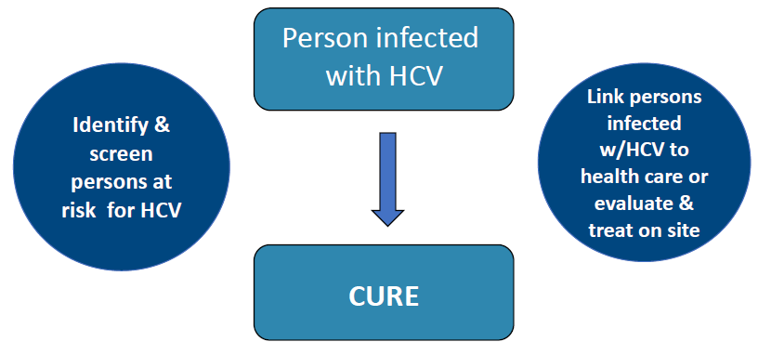
Bridging the Gap to a Cure
34
Notes:
Slide courtesy of Bob Jope, LMHC
HCV can be safely cured with all-oral therapies in the vast majority (>95%) of patients.
REFERENCE:
Jope, B. (2025). Understanding Hepatitis C for Human Service Professionals. TA Session presented on behalf of the ATTC of New England. Available at: https://attcnetwork.org/wp-content/uploads/2025/08/Understanding-Hepatitis-C-for-Human-Service-Professionals.pdf.

Slide 35

HCV Testing
Initial test (Screen)
Tests for HCV anti-bodies
Enzyme immunoassay (EIA)
Confirm positive result with a PCR test
Confirm the type of HCV
This is done by genotyping
There are six genotypes of HCV
The genotype impacts which treatment agent is used / will be most effective
Fibrosis staging
Liver scarring that can lead to cirrhosis
Impairs liver functioning
35
Notes:
There are several tests for hepatitis C. Consult with your doctor/nurse to determine the type of test you need. The first is an HCV antibody test.
There are different ways to test for HCV antibodies:
Lab-based: The doctor or nurse will take a sample of your blood and send it to the lab for analysis, which will take longer to get results.
Quick test/rapid test: This is usually called a "rapid point of care" test because the doctor or nurse will take a sample of your blood and be able to analyze it in about 30 minutes.
Home-based: You take a sample of your own blood and send it to a lab to be analyzed.
All three tests look for antibodies to HCV in your blood. Antibodies are proteins produced and released into the bloodstream as a defense when someone gets infected.
Antibody tests are used to find out if you have ever been infected with HCV. If the result is positive or reactive it may not mean that you currently have hepatitis C.
If your antibody test is positive or reactive, the doctor or the lab will automatically do a second test on your blood to see if you still have the virus in your body. This test is called a qualitative nucleic acid test (NAT) for HCV RNA, and it looks for the presence of the virus in your blood.
If you might have been exposed to HCV within the past 6 months, your doctor should order a NAT for HCV RNA rather than an HCV antibody test.
REFERENCE:
Centers for Disease Control and Prevention. (2025). [Webpage]. Testing for Hepatitis C. Accessed November 14, 2025, from: https://www.cdc.gov/hepatitis-c/testing/index.html.

Slide 36
How to Interpret HCV Test Results (1)
Test Outcome | Interpretation | Further Actions
HCV antibody non-reactive | No HCV antibody detected | Sample can be reported as nonreactive for HCV antibody. No further action required. If recent exposure is suspected, test for HCV RNA.*
HCV antibody reactive | Presumptive HCV infection | A repeatedly reactive result could be consistent with current HCV infection, past HCV infection that has resolved, or biologic false positivity for HCV antibody. Test for HCV RNA to identify current infection.
* If HCV RNA testing is not feasible and person tested is not immunocompromised, do follow-up testing for HCV antibody to demonstrate seroconversion. If the patient tested is immunocompromised, consider testing for HCV RNA.
36
Notes:
Based on your results and type of test, you may or may not need follow-up testing.
Non-reactive antibody test result
A non-reactive — or negative — antibody test result means you are not currently infected with HCV. If you don't have antibodies in your blood, your doctor won't need to do the follow-up NAT HCV RNA test.
However, if you think you might have been exposed to hepatitis C in the last 6 months, you will need to be tested again for antibodies.
Reactive antibody test result
A reactive — or positive — antibody test result means you have been infected with HCV at some point in your life. Once infected, you will always have antibodies in your blood. This is true if you have cleared the virus, have been cured, or still have the virus in your blood.
If your antibody test is reactive, the doctor will automatically test your blood sample for the virus using the NAT for HCV RNA.
If the NAT for HCV RNA is negative, that means you were previously infected with HCV but it is no longer in your body.
If the NAT test is positive, that confirms you are currently infected with HCV.
REFERENCE:
Centers for Disease Control and Prevention. (2025). [Webpage]. Clinical Screening and Diagnosis for Hepatitis C. Accessed November 14, 2025, from: https://www.cdc.gov/hepatitis-c/hcp/diagnosis-testing/index.html.

Slide 37
How to Interpret HCV Test Results (2)
Test Outcome | Interpretation | Further Actions
HCV antibody reactive, HCV RNA detected | Current HCV infection | Provide person tested with appropriate counseling and link to care and treatment.†
HCV antibody reactive | Presumptive HCV infection | A repeatedly reactive result could be consistent with current HCV infection, past HCV infection that has resolved, or biologic false positivity for HCV antibody. Test for HCV RNA to identify current infection.§
† It is recommended before initiating antiviral therapy to retest for HCV RNA in a subsequent blood sample to confirm HCV RNA positivity.
§ If the patient is suspected of having HCV exposure within the past 6 months, or has clinical evidence of HCV disease, or if there is concern regarding the handling or storage of the test specimen, the clinician should follow up with the patient.
37
Notes:
Based on your results and type of test, you may or may not need follow-up testing.
Non-reactive antibody test result
A non-reactive — or negative — antibody test result means you are not currently infected with HCV. If you don't have antibodies in your blood, your doctor won't need to do the follow-up NAT HCV RNA test.
However, if you think you might have been exposed to hepatitis C in the last 6 months, you will need to be tested again for antibodies.
Reactive antibody test result
A reactive — or positive — antibody test result means you have been infected with HCV at some point in your life. Once infected, you will always have antibodies in your blood. This is true if you have cleared the virus, have been cured, or still have the virus in your blood.
If your antibody test is reactive, the doctor will automatically test your blood sample for the virus using the NAT for HCV RNA.
If the NAT for HCV RNA is negative, that means you were previously infected with HCV but it is no longer in your body.
If the NAT test is positive, that confirms you are currently infected with HCV.
REFERENCE:
Centers for Disease Control and Prevention. (2025). [Webpage]. Clinical Screening and Diagnosis for Hepatitis C. Accessed November 14, 2025, from: https://www.cdc.gov/hepatitis-c/hcp/diagnosis-testing/index.html.

Slide 38
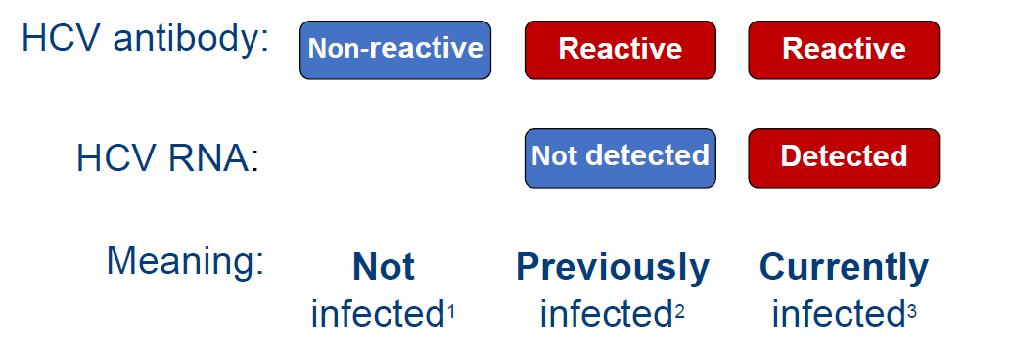
Understanding Screening Results
Additional testing as appropriate:
¹Unless in window period (recently infected) or immunocompromised
²Repeat HCV RNA test in six months to be sure
³Needs medical evaluation to assess state and consider the treatment
38
Notes:
Slide courtesy of Bob Jope, LMHC
The figure on this slide is an alternate way to summarize screening results and actions/next steps depending on results of screening tests.
REFERENCE:
Jope, B. (2025). Understanding Hepatitis C for Human Service Professionals. TA Session presented on behalf of the ATTC of New England. Available at: https://attcnetwork.org/wp-content/uploads/2025/08/Understanding-Hepatitis-C-for-Human-Service-Professionals.pdf.

Slide 39
Non-reactive Counseling Messages
To stay negative or uninfected, eliminate or reduce risk by:
Not sharing needles or other injection equipment or snorting items
Only getting tattoos, piercings, and body art from a licensed artist
Getting vaccinated against hepatitis A and B and test for HIV
Practicing safer sex and getting treated for STIs
If a person engaged in risky behavior within the past six months, they should get re-tested (HCV RNA) in six months.
39
Notes:
Slide courtesy of Bob Jope, LMHC
This slide provides a list of non-reactive counseling messages to share with clients/patients.
REFERENCE:
Jope, B. (2025). Understanding Hepatitis C for Human Service Professionals. TA Session presented on behalf of the ATTC of New England. Available at: https://attcnetwork.org/wp-content/uploads/2025/08/Understanding-Hepatitis-C-for-Human-Service-Professionals.pdf.

Slide 40
Reactive Counseling Messages
HCV RNA test measures the amount of HCV in your blood
If there is no virus, the test will come back “not detected.” If “detected,” then you are infected with hepatitis C
One in five people exposed to HCV are infected; getting an HCV RNA test is critically important*
Protect the liver by avoiding alcohol and practicing other risk-reduction behavior
See a doctor to learn about hepatitis C and HCV treatment.
*Encourage reflexive RNA testing/one step diagnostic.
40
Notes:
Slide courtesy of Bob Jope, LMHC
This slide provides a list of reactive counseling messages to share with clients/patients.
REFERENCE:
Jope, B. (2025). Understanding Hepatitis C for Human Service Professionals. TA Session presented on behalf of the ATTC of New England. Available at: https://attcnetwork.org/wp-content/uploads/2025/08/Understanding-Hepatitis-C-for-Human-Service-Professionals.pdf.

Slide 41
Linkage to Care
Peer navigation
Warm hand-offs from testing to treatment
Integration in MOUD and other SUD treatment settings
41
Notes:
Slide courtesy of Bob Jope, LMHC
Connecting a patient to further care and treatment within 30 days of diagnosis greatly improves the likelihood of cure. Promoting and linking persons infected with HCV to appropriate health care services can be initiated at various points of patient contact and in a variety of care settings, including:
Primary care
Emergency rooms
HIV testing sites
Substance use disorder treatment programs
Mental health treatment programs
OTPs
STI clinics
Community-based outreach programs
Shelters for individuals who are unhoused
REFERENCE:
Jope, B. (2025). Understanding Hepatitis C for Human Service Professionals. TA Session presented on behalf of the ATTC of New England. Available at: https://attcnetwork.org/wp-content/uploads/2025/08/Understanding-Hepatitis-C-for-Human-Service-Professionals.pdf.

Slide 42
Treatment of HCV in People Who Use Drugs
Part three
Notes:
(20 minutes)
In Part Three of the webinar, participants will learn about:
Overview of direct-acting antiviral (DAA) therapies – efficacy, duration, and cure rates (SVR12).
Addressing misconceptions (“people who use drugs cannot adhere to HCV treatment”).
Integration of HCV treatment within opioid treatment programs (OTPs), primary care, and correctional settings.
Drug-drug interactions: DAAs with buprenorphine, methadone, and other OUD medications.
Key References:
Grebely, J., et al. (2018). Simplified HCV treatment in people who inject drugs: Outcomes and barriers. Lancet Gastroenterol Hepatol, 3(3), 153-161.
AASLD-IDSA. (2023). HCV Guidance.
Litwin, A. H., et al. (2020). Integrated models of HCV and OUD care. Journal of Substance Abuse Treatment, 108, 29-35.

Slide 43
The Realities of HCV Treatment for People Who Use Drugs
Reality #1: Adherence rates are equal to or higher than in the general population (Grebely et al., 2018).
Reality #2: Patients do not need to abstain from using drugs before starting HCV treatment (AASLD/IDSA, 2023).
Reality #3: Reinfection risk is high in the immediate post-treatment period, though decreases significantly over time (Litwin et al., 2024).
43
Notes:
Negative attitudes and perceptions experienced by people who use drugs and outdated policies are barriers; evidence does not support withholding treatment from people who use drugs.
In the Litwin et al. cohort study of 415 people who inject drugs (PWID; 2024)., the overall reinfection rate was 11.4 per 100 person-years at risk over 518 person-years of follow-up. Rates of reinfection decreased significantly with increasing post-treatment follow-up (weeks 0-24, 15.5 per 100 person-years; weeks 73-144, 4.3 per 100 person-years).
REFERENCES:
Grebely, J., Larney, S., Peacock, A., Colledge, S., Leung, J., Hickman, M., Vickerman, P., Blach, S., Cunningham, E. B., Dumchev, K., Lynskey, M., Stone, J., Trickey, A., Razavi, H., Mattick, R. P., Farrell, M., Dore, G. J., & Degenhardt, L. (2019). Global, regional, and country-level estimates of hepatitis C infection among people who have recently injected drugs. Addiction, 114(1), 150-166. doi: 10.1111/add.14393. Epub 2018 Aug 28. PMID: 30035835; PMCID: PMC6657799.
The American Association for the Study of Liver Diseases and the Infectious Diseases Society of America. (2023). HCV Guidance: Recommendations for Testing, Managing, and Treating Hepatitis C. Alexandria, VA: Author.
Litwin, A. H., Tsui, J. I., Heo, M., et al. (2024). Hepatitis C virus reinfection among people who inject drugs: Long-term follow-up of the HERO Study. JAMA Netw Open, 7(8):e2430024. doi:10.1001/jamanetworkopen.2024.30024

Slide 44

Treatment Options – We Can Say Cure
HCV is the only strain of hepatitis than can be cured
New treatments offer a functional cure in > 95% of cases
Direct-acting antiviral agents (DAAs)
Significant advantages over the older antiviral treatments (i.e., interferon)
Easier to take – fewer doses, shorter duration
Far fewer side effects
Can be taken with late-stage liver damage
3 classes of DAAs based on what they target
NS3/4A protease inhibitors
NS5S polymerase inhibitors
NS5B polymerase inhibitors
Some formulations have multiple DAAs
i.e., glecaprevir + pibrentasvir
Class of DAA chosen based on the HCV genotype results
44
Notes:
HCV is now curable for nearly everyone, including people actively using drugs. This is a message we need to amplify – treatment is simple, safe, and highly effective.
The use of ribavirin with interferon or peginterferon is no longer recommended due to poor efficacy and high rate of adverse effects with the regimen. DAA therapy is better tolerated and more effective and has a shorter duration.
There are 3 types of later, next-generation DAA therapies for non-pregnant adults and children over age 3:
Protease inhibitors
Nucleoside analog polymerase inhibitors
Nonstructural protein 5A (NS5A) inhibitors
Many agents have antiviral activity against all genotypes.
DAA therapies are not approved for pregnant patients and children under 3. There are efforts underway to develop prenatal treatment options and/or infant antiviral postexposure prophylaxis to prevent perinatal transmission.
REFERENCES:
Centers for Disease Control and Prevention. (2025). [Webpage]. Clinical Care of Hepatitis C. Accessed November 13, 2025, from: https://www.cdc.gov/hepatitis-c/hcp/clinical-care/index.html.
U.S. Department of Veterans Affairs. (2023). [Webpage]. Viral Hepatitis and Liver Disease – Classification of Direct-Acting Antiviral Agents in HCV Treatment Regimens. Accessed November 18, 2025, from: https://www.hepatitis.va.gov/hcv/treatment/hcv-daa-class.asp.
Hepatitis C Online. (2025). [Webpage]. HCV Medications. Accessed November 13, 2025, from: https://www.hepatitisc.uw.edu/page/treatment/drugs.

Slide 45

Treatment Success
> 95% cure rate – this is incredible
Treatment duration can be 8 to 24 weeks
Cure rates were high even in populations with low adherence to treatment regimen
In one study, participants with at least 50% adherence still had a 99% cure rate
45
Notes:
Norton and colleagues measured a group of people who inject drugs on their adherence to their HCV treatment regimen through electronically monitored blister packs. Those participants who took at least 50% of their doses still had a sustained virologic response rate of 99%. Even those participants who only managed to take ½ of their treatment still were cured 99% of the time.
This is a GREAT option for a treatment population that often gets missed. Even if they don’t complete their treatment, they may be cured from HCV and prevent future liver damage.
The University of Liverpool has a Hep C Drug Interaction Checker/Tool that can be accessed at: https://hep-druginteractions.org/checker. Buprenorphine and methadone is generally safe to take with DAAs.
REFERENCE:
Norton, B. L., Akiyama, M. J., Agyemang, L., Heo, M., Pericot-Valverde, I., & Litwin, A. H. (2020). Low Adherence Achieves High HCV Cure Rates Among People Who Inject Drugs Treated With Direct-Acting Antiviral Agents. Open forum infectious diseases, 7(10), ofaa377.

Slide 46
Barriers to HCV Treatment
Lack of awareness
Negative attitudes and perceptions
Two-step diagnostic testing
High drug costs
Insurance coverage gaps
Insurance treatment restrictions
Treatment not co-located
Hardly reached populations
46
Notes:
HCV treatment – provided in specialty settings – this is a barrier because if there are limited number of specialists available, it creates restricted access to treatment, long wait time, and loss of follow up
Stigma – as mentioned HCV is associated with PWID and various health care settings are reluctant to integrate HCV services in their facility
Insurance – some insurance require prior authorization for HCV treatment. it increases provider workload and can widen the disparities in access to HCV treatment
Sobriety restrictions - Restrictions based on sobriety require patients to be abstinent of alcohol or other drugs before approval of HCV treatment, there have been multiple studies that show high HCV rates regardless of ongoing substance use
REFERENCES:
Fleurence, R. L, & Collins, F. S. (2023). A National Hepatitis C Elimination Program in the United States: A historic ppportunity. JAMA, 329(15), 1251–1252. doi:10.1001/jama.2023.3692
Hepatitis C Online. (2025). Addressing structural barriers to HCV treatment - core concepts. (n.d.). https://www.hepatitisc.uw.edu/pdf/evaluation-treatment/addressing-structural-barriers-to-treatment/core-concept/all

Slide 47
Helping Patients Stay Well (1)
Your patient is considered cured of hepatitis C if there is no detectable HCV RNA after 12 weeks of treatment. This indicates they have had a sustained virologic response to therapy.
To help your patient stay well, you should also talk to them about:
Maintaining a healthy diet and active lifestyle.
Avoiding excessive alcohol intake.
Checking with a provider before taking new prescription pills, over-the-counter drugs, or supplements.
47
Notes:
Your patient is considered cured of hepatitis C if there is no detectable HCV RNA after 12 weeks of treatment. This indicates they have had a sustained virologic response to therapy. This slide contains items you can discuss with patients to help them stay well following treatment.
REFERENCE:
Centers for Disease Control and Prevention. (2025). [Webpage]. Clinical Care for Hepatitis C. Accessed November 14, 2025, from: https://www.cdc.gov/hepatitis-c/hcp/clinical-care/index.html.

Slide 48
Helping Patients Stay Well (2)
Remind patients of proper practices to avoid HCV transmission while on treatment and to avoid reinfection after successfully completing treatment, like:
Avoiding activities that can lead to transmission, like sharing injection drug use equipment.
Avoiding blood, tissue, and semen donation.
48
Notes:
Your patient is considered cured of hepatitis C if there is no detectable HCV RNA after 12 weeks of treatment. This indicates they have had a sustained virologic response to therapy. This slide contains items you can discuss with patients to help them stay well following treatment.
REFERENCE:
Centers for Disease Control and Prevention. (2025). [Webpage]. Clinical Care for Hepatitis C. Accessed November 14, 2025, from: https://www.cdc.gov/hepatitis-c/hcp/clinical-care/index.html.

Slide 49
HCV Treatment Barriers (CHATBOX)
ACTIVITY
What barriers does your organization face with HCV service integration?
Please include where you’re from.
49

Slide 50
The Role of OTPs in Addressing HCV (and Other Infectious Diseases)
OTPs are uniquely positioned to offer HIV, HCV, and syphilis screening and linkage to care due to their existing relationships with patients disproportionately impacted by these conditions.
Addressing the broader syndemic can improve healthcare, recovery, and quality of life outcomes for OTP patients experiencing multiple health issues, through:
Access to more trauma-informed prevention, treatment, and care
Stronger patient-centered relationships
Adherence to treatment plans
50
Notes:
The close relationships between substance use and HIV, HCV, and syphilis, as well as the implications of leaving any of these conditions untreated, make a strong case for addressing infectious disease in OTP settings. Addressing the broader syndemic can improve healthcare,
recovery, and quality of life outcomes for OTP patients experiencing multiple health issues, through access to more trauma-informed prevention, treatment and care; stronger patient- centered relationships; and adherence to treatment plans. For example, studies have
shown that that if barriers to access and care can be systematically addressed in a culturally appropriate and trauma-responsive environment, HCV assessment and treatment integrated care models can be successful.
Taking an integrated approach, in which OTPs incorporate infectious disease screening, linkage, and treatment interventions alongside substance use services, is especially important given the interrelated vulnerabilities of OTP patients to infectious disease. OTP patients are also more likely to be experiencing housing instability or homelessness, poverty, and/or the impacts of structural racism, as well as other social determinants of health that drive negative health outcomes. OTP clients who are connected to primary care have been found to receive less chronic care management and infectious disease treatment than their counterparts who are not in OTPs,42 despite being disproportionately burdened with HIV, HCV, and/or syphilis. Furthermore, many OTP patients may not engage in primary care at all beyond required OTP visits, meaning that OTP settings may provide the only opportunities for patients to receive routinized infectious disease screening and linkage to care services.
REFERENCE:
Opioid Response Network. (2024). Your Guide to Integrating Infectious Disease Testing and Treatment Services in Opioid Treatment Programs. Providence, RI: Author.

Slide 51
Medications for Opioid Use Disorders: Antagonists, Partial Agonists, and Full Opioid Agonists
Full Agonist
(e.g., methadone)
Opioid
Effect
Partial Agonist
(e.g. buprenorphine)
Antagonist
(e.g. naloxone)
Dose of Opioid
51
Notes:
51
This slide graphically depicts the different types of opioids (whether they are prescribed medications such as Vicodin or methadone, or an illicit substance, like heroin).
Move forward to reveal first line (full agonist)
Full agonists (e.g., heroin, opium, Vicodin, methadone, etc.) fully activate the receptors so that the more you use, the more effect you experience. If someone continues to use, they will eventually experience overdose and, possibly, death.
The following metaphor may be helpful in explaining the differences between the types of opioids:
Opioid agonists work like having the right key to a door. You put the key in the lock, the lock turns and the door opens completely.
Move forward to reveal the next line (antagonists)
Opioid antagonists (e.g., naltrexone, naloxone) fill the receptors and block the action of other opioids. If the person has used an opioid agonist, the antagonist will replace it on the receptor and the person will experience withdrawal. If the person is stable on an antagonist, and uses another opioid, the antagonist will block the effects, preventing the user from experiencing the high.
The door metaphor continued:
Opioid antagonists work like having the wrong key to a door. You put the key in the lock; the door remains locked and will not open. Additionally, since the key is in the lock, no other key can be put in the lock (even if it is the right key for that door) until the wrong key is removed.
Move forward to reveal the last line (partial agonists)
Opioid partial agonists (e.g., buprenorphine) are in the middle. At lower doses, they work just like agonists, filling the receptor and preventing withdrawal symptoms. However, as the dose increases, a ceiling effect occurs so that if more is used, no more effect is achieved. This ceiling effect applies both to opioid euphoria (they don’t feel high), and to the respiratory suppression (making overdose less likely).
The door metaphor continued:
Opioid partial agonists work like having the right key to a door, but the chain is on the door. The key goes in and opens the door, but it will only open so far.
Medications for Opioid Use Disorder – NIDA available at: https://www.youtube.com/watch?v=jn3EsvHlvMo&t=10s

Slide 52
OBOTs and OTPs
Feature | OBOT | OTP
Treatment Setting | Primary Care/General Med. Practice | Dedicated, specialized clinic
Prescribing Physicians | PCPs who prescribe medications (e.g., buprenorphine) | Accredited physicians certified to administer MAT, incl. methadone
Medications | Can prescribe buprenorphine | Can administer methadone, buprenorphine, and naltrexone
Counseling | Not federally required; providers may offer/refer | Typically includes integrated counseling and support services
Structure | More flexible and accessible | Highly structured, often with specialized staff and more intensive support
Accessibility | Good for areas with limited access to specialized clinics | Provides dedicated, specialized environment for those who need it
52
Notes:
OBOT (Office-Based Opioid Treatment) and OTP (Opioid Treatment Program) are both forms of outpatient care for opioid use disorder, but they differ in structure and scope. OBOT integrates treatment into primary care settings, allowing general practitioners to prescribe medications like buprenorphine, while OTPs are more specialized, multi-disciplinary clinics that are the only settings authorized to administer methadone and often have more comprehensive, on-site counseling and support services.
https://www.aatod.org/wp-content/uploads/2023/06/Comparison-Document_OTP-and-OBOT_FINAL3.2023.pdf

Slide 53
OTP Requirements
Opioid Treatment Programs (OTPs)
SAMHSA’s Division of Pharmacologic Therapies (DPT) manages day-to-day oversight activities
DPT supports the certification and accreditation of more than 1,900 OTPs that collectively treat more than 600,000 patients annually.
Statutes, regulations, and guidelines can be found at: https://www.samhsa.gov/substance-use/treatment/statutes-regulations-guidelines
53
Notes:
REFERENCES:
https://www.samhsa.gov/substance-use/treatment/opioid-treatment-program
https://www.samhsa.gov/substance-use/treatment/statutes-regulations-guidelines

Slide 54
More about OTPs
Opioid Treatment Programs (OTPs)
Provide medication-assisted treatment (MAT) for individuals diagnosed with an opioid use disorder (OUD) (Opioid treatment programs (OTP). CMS.gov. (n.d.-b))
Medications used to treat OUD
Buprenorphine – suppresses + reduces cravings for opioids
Methadone – reduces opioid cravings and withdrawals, blunts/blocks the effects of opioids
Naltrexone – blocks euphoric + sedative effects of opioids + prevents feelings of euphoria
State | Number of OTPs
Arizona | 73
California | 166
Hawai’i | 4
Nevada | 16
PIaUS | 0
Total # of OTPs in United States | 2,117
Source: Opioid treatment program directory. hhs.gov. (As of 12/2/25)
54
Notes:
REFERENCES:
Opioid treatment programs (OTP). CMS.gov. (n.d.-b). https://www.cms.gov/medicare/payment/opioid-treatment-program#:~:text=Opioid%20Treatment%20Programs%20(OTPs)%20provide,%2C%20SAMHSA%2Dapproved%20accrediting%20body.
Opioid treatment program directory. hhs.gov. (n.d.). https://dpt2.samhsa.gov/treatment/directory.aspx
Medications, counseling, and related conditions. SAMHSA. (n.d.). https://www.samhsa.gov/medications-substance-use-disorders/medications-counseling-related-conditions#:~:text=Buprenorphine%2C%20methadone%2C%20and%20naltrexone%20are,years%2C%20or%20even%20a%20lifetime.

Slide 55
Medicaid & Medicare Advantage Plans: OTPs
Medicaid
SUPPORT Act – mandates all state cover OTP in their Medicaid programs (effective October 1, 2020)
For Medi-Medi patients, Medicare is now the primary payer for OTP services (effective January 1, 2020)
OTP providers need to enroll as a Medicare Provider to bill Medicare
Medicare Advantage (MA) Plans
MA plans must include the OTP benefit (effective as of January 1, 2020)
Contract with OTP providers in service area or agree to pay an OTP on noncontract basis
May require enrollees to receive OTP services though contracted OTP facilities
55
Notes:
REFERENCES:
Medicaid. CMS.gov. (n.d.-a). https://www.cms.gov/medicare/payment/opioid-treatment-program/Medicaid
Medicare Advantage Plans. CMS.gov. (n.d.-b). https://www.cms.gov/medicare/payment/opioid-treatment-program/medicare-advantage-plans

Slide 56
HCV Testing in OTPs in the U.S.
Facilities that offer medications for OUD treatment i.e., methadone, buprenorphine, and/or naltrexone are ideal settings to co-locate HCV services
They serve high-risk populations and medication for OUD is associated with improved HCV treatment outcomes
SAMHSA recommend that OTPs screen high-risk patients for HCV
OTPs in 2020 – 65% offered HCV testing and 10.7% offered treatment
56
Notes:
Patel, E. U., Genberg, B. L., Zhu, X., Krawczyk, N., Mehta, S. H., & Tobian, A. A. (2022). HIV and hepatitis C virus testing and treatment services in specialty treatment facilities that offer medication for opioid use disorder in the US. JAMA, 327(8), 776. https://doi.org/10.1001/jama.2022.0293
https://www.ncbi.nlm.nih.gov/pmc/articles/PMC8864507/#:~:text=Among%20OTPs%20in%202020%2C%2059.0,%3D%20188)%20offered%20HCV%20treatment.

Slide 57
Top Tips for Treating HCV in OTPs and Other SUD Treatment Settings
Intake labs with single blood draw are critical
Embedded care navigators increase treatment
Insurance or lack thereof can complicate medications
Find the window of opportunity to treat
Involve counselors include engagement as treatment
OTP dispensary can assist with medication delivery
57
Notes:
Slide courtesy of Sarah Rowan, MD
This slide presents top tips for treating HCV in OTPs and other SUD treatment settings.
REFERENCE:
Rowan, S. (2025). Hepatitis C, HIV, and Substance Use Disorders. Workshop presented at the 6th Annual Guam Virtual Conference on Behavioral Health and Addictions.

Slide 58
Barriers to Treating HCV in OTPs and Other SUD Treatment Settings
Most people are not ready if still in active withdrawal
The quality of your care navigator is critical
SUD treatment is often run by psychiatry not medicine
Be careful to decouple offerings, need non-punitive approach
Many clients know people treated in the interferon days
Some clients may be cautious about potential for reinfection
58
Notes:
Slide courtesy of Sarah Rowan, MD
Withdrawal is feared, but allowing people fast access to supportive medications often works. In focus groups, best message is that treating hepatitis C prevents liver cancer. Medications are bulky, people experiencing homelessness may appreciate assistance with med storage
For many OTPs, the shift toward a syndemic approach may seem daunting. Integrating infectious disease services into existing programs may require significant changes to organizational culture, policies, procedures, and staffing. Common barriers to integrated services at OTPs include a lack of medical and behavioral health provider capacity, insufficient patient demand, lack of funding, and/or regulatory concerns.55 While some of these barriers may require state or federal policy changes, SAMHSA and CDC are offering unprecedented support to build the capacity of OTPs and other healthcare organizations to address OUD, SUD, and infectious disease.
REFERENCES:
Rowan, S. (2025). Hepatitis C, HIV, and Substance Use Disorders. Workshop presented at the 6th Annual Guam Virtual Conference on Behavioral Health and Addictions.
Opioid Response Network. (2024). Your Guide to Integrating Infectious Disease Testing and Treatment Services in Opioid Treatment Programs. Providence, RI: Author.

Slide 59
MOUD as HCV Prevention
Methadone and buprenorphine reduce frequency of opioid injection
Reduced high-risk behaviors
Improved engagement in health care
Lower re-infection rates
59
Notes:
Medications for opioid use disorder (MOUD) act as a preventative measure for Hepatitis C (HCV) by reducing injection drug use and associated risky behaviors. By decreasing illicit opioid use through medications like methadone and buprenorphine, MOUD lowers the risk of individuals sharing contaminated injection equipment and subsequently acquiring HCV. Research has shown that MOUD programs can significantly reduce the risk of HCV acquisition and, when combined with other harm reduction strategies, have an even greater protective effect.
How MOUD prevents HCV
Decreased injection frequency: MOUD helps individuals reduce or stop the use of non-prescribed opioids, which directly decreases the frequency of injections.
Reduced high-risk behaviors: The stability offered by MOUD can lead to reduced engagement in behaviors that increase the risk of transmitting HCV, such as sharing needles or other injection equipment.
Lower risk of reinfection: For individuals already treated for HCV, MOUD can prevent reinfection by reducing the relapse into drug use, which is linked to reinfection risk.
Evidence of effectiveness
MOUD programs have been linked to a 50% reduction in the risk of acquiring HCV.
Studies show that combining MOUD with syringe service programs (SSPs) can lead to a 6- to 7-fold decrease in the risk of HCV seroconversion.
Additional benefits of MOUD
Reduced overdose risk: MOUD is a proven strategy to decrease the risk of overdose death among people who use opioids.
Improved overall health: By managing opioid use disorder, MOUD can lead to better overall health outcomes and reduced engagement in other high-risk activities, like polysubstance use.
Combining MOUD with other strategies
The most effective prevention occurs when MOUD is combined with other harm reduction services, such as syringe service programs and overdose prevention education.
Integrated care models that combine MOUD and HCV treatment have shown improved HCV cure rates and better adherence to both treatments.
REFERENCES:
Spaderna, M., Kattakuzhy, S., Kang, S. J., George, N., Bijole, P., Ebah, E., Eyasu, R., Ogbumbadiugha, O., Silk, R., Gannon, C., Davis, A., Cover, A., Gayle, B., Narayanan, S., Pao, M., Kottili, S., & Rosenthal, E. (2023). Hepatitis C dure and medications for opioid use disorder improve health-related quality of life in patients with opioid use disorder actively engaged in substance use. International Journal of Drug Policy, 111, 103906. https://doi.org/10.1016/j.drugpo.2022.103906.
Springer, S. A., & del Rio, C. (2020). Co-located opioid use disorder and hepatitis C virus treatment is not only right, but it is also the smart thing to do as it improves outcomes! Clin Infect Dis, 71(7), 1723-1724. doi: 10.1093/cid/ciaa111. PMID: 32011653; PMCID: PMC7583407.

Slide 60
Implementing Integrated HCV + OUD Care Models
Part five
Notes:
(10 minutes)
In Part Five of the webinar, participants will learn about:
“One-Stop” integrated care – co-located addiction and HCV services.
Use of peer recovery specialists and case management.
Telehealth models and low-barrier access.
Funding and policy support (Ryan White, HRSA, state initiatives).
Key References:
Cunningham, E. B., et al. (202). Integrated care models for HCV and OUD: Systematic review. Addiction, 117(4), 1045-1060.
HRSA. (2024). Integrating HCV Care into Substance Use Disorder Treatment Settings.

Slide 61
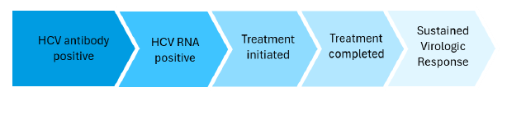
HCV Care Cascade
61
Notes:
The cascade of care is a way to organize and assess how a linkage model moves patients through a sequence of engagement in care, from prevention to screening to treatment to cure (if applicable). By identifying the key steps between engagement in care and treatment (or cure), care cascades can help conceptualize interventions and identify key evaluation activities and metrics at each step of the cascade.
REFERENCE:
Opioid Response Network. (2024). Your Guide to Integrating Infectious Disease Testing and Treatment Services in Opioid Treatment Programs. Providence, RI: Author.

Slide 62
Accessible Hepatitis C Care for People Who Inject Drugs: A Randomized Clinical Trial
In a randomized sustained virologic response with treatment within 12 months was achieved by:
67% of patients in the accessible care group
Only 23% of people in usual care had the same result.
62
Notes:
Question Is the accessible care model, which is characterized by low-threshold care co-located in an overdose prevention program, better at curing people who inject drugs of hepatitis C virus (HCV) infection compared with facilitated referral?
Findings In this single-site randomized clinical trial of patients with HCV, 167 adults with recent injection drug use were enrolled. Sixty-seven percent of participants who received accessible care treatment vs 23% of those who received usual care (facilitated referral) achieved a hepatitis C virus cure (sustained virologic response), which was a significant difference.
Meaning The results of this randomized clinical trial suggest that the accessible care model provides a framework for developing treatment programs geared toward engaging, treating, and curing HCV infection in people who inject drugs.
REFERENCE:
Eckhardt, B., Mateu-Gelabert, P., Aponte-Melendez, Y., et al. (2022). Accessible Hepatitis C care for people who inject drugs: A randomized clinical trial. JAMA Intern Med, 182(5), 494–502. doi:10.1001/jamainternmed.2022.0170

Slide 63
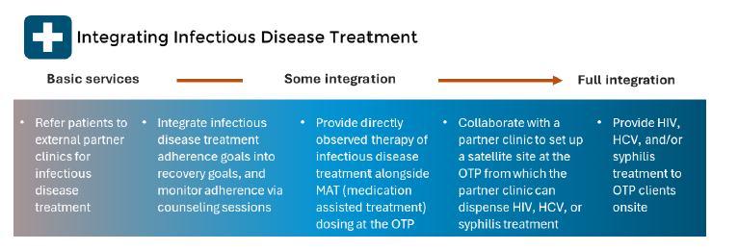
Integrating HCV Treatment into OUD Care**
**Refer to Handouts
63
Notes:
Jope PDF slide 59-60
Failure to diagnose and effectively treat HIV, HCV, and syphilis can cause significant organ damage and even death, underscoring the importance of efficient and effective linkage-to- care protocols for OTP patients with these conditions. Treatment options have advanced significantly. Direct acting antivirals for HCV are curative in >95% of patients.37 Penicillin or doxycycline can cure syphilis (and intravenous penicillin, for neurosyphilis or congenital syphilis), with dosage depending on the type and stage of syphilis.38 While HIV is not curable, it can be effectively managed with anti-viral medications.34
This slide features a graphic detailing the spectrum of ways that OTPs might integrate infectious disease treatment, ranging from less to more integration.
REFERENCE:
Opioid Response Network. (2024). Your Guide to Integrating Infectious Disease Testing and Treatment Services in Opioid Treatment Programs. Providence, RI: Author.

Slide 64
Lessons from the Field: Additional Tips for Integrated Services
Be aware of state policies and resources related to HCV screening and linkage.
Universal screening simplifies and streamlines integration.
Drivers of effective workflow are diverse.
Anticipating and addressing patient barriers to care is key to patient success.
64
Notes:
Be aware of state policies and resources related to HIV, HCV, and syphilis screening and linkage. For example, different states may have different Medicaid restrictions71 for HCV treatment or different eligibility criteria for support of the AIDS Drug Assistance Program (ADAP). It is essential to be aware of policy-driven barriers to infectious disease screening and treatment that may impact OTP patients, such as sobriety or prescriber restrictions, and to develop strategies
around maneuvering these barriers and communicating them to patients. Having a strong foundational knowledge in these areas supports efficient clinic workflow.
Universal screening simplifies and streamlines integration. As most patients in many OTPs could be considered high risk for HIV, HCV, and/or syphilis, universal, “opt-out” testing, in which all patients are offered screening by default at intake unless they refuse, may be more expedient than identifying higher risk patients through assessment. Consider rescreening annually based on history and risk factors.
Drivers of effective workflow are diverse. A variety of strategies contribute to workflow efficiency. For some OTPs, improving workflow might take the form of an in-house lab that processes all initial test results. For other OTPs, EHR flags have helped identify patients requiring follow up screening or treatment appointments. Other forms of workflow efficiency have included formal MOUs with FQHCs to provide treatment, peer support specialists who follow patients through treatment, and using telehealth for consultation between on-site and external clinicians about HCV treatment.
Anticipating and addressing patient barriers to care is key to patient access. OTP patients may experience major barriers to accessing integrated or coordinated screening or treatment, such as a lack of access to transportation for external
appointments and competing basic needs. Addressing these barriers, such as through rideshare vouchers, providing transportation, and using contingency management (motivational incentives like gift cards or small cash payments for completing care steps or appointments), is key to success.

Slide 65
Integrated Care Models
Co-located or shared-care models
Care coordination and navigation
OTP-Integrated Facilitated Telemedicine for HCV Treatment
Peer-Assisted Telemedicine for Hepatitis C (PATHS)
65
Notes:
Integrated care is cost-effective and improves viral clearance and OUD retention simultaneously (Cunningham et al., 2023).
OTP-Integrated Facilitated Telemedicine for Hepatitis C Treatment: Background: Hybrid effectiveness-implementation designs evaluate the effectiveness and implementation of interventions. We retrospectively evaluated the implementation of a stepped-wedge cluster randomized controlled trial of a facilitated telemedicine model (experimental) integrated into opioid treatment programs (OTPs) compared to offsite referral (control) for hepatitis C virus (HCV) treatment. The trial period was March 2017–October 2022. We compared organizational and implementation characteristics associated with an HCV cure and with high satisfaction with healthcare delivery. Methods: We used the Reach, Effectiveness, Adoption, Implementation, Maintenance (RE-AIM) framework to guide data collection and evaluation. We evaluated the clinical effectiveness outcome (HCV cure) and patient-centered outcomes (changes between in-person and telemedicine patient satisfaction questionnaire subscales: Time Spent With Doctor and General Satisfaction). We evaluated 7 organizational and 16 implementation variables. We used random forests to obtain a list of variables with total importance weight of at least 95%. We subsequently conducted a configurational comparative method of coincidence analysis (CNA) to identify the variable combinations that are associated with the best outcomes Results: The effectiveness of reach was enhanced by site identification of HCV RNA positive individuals. We found that low patient load per provider or counselor, site liaison presence, and high case manager availability increased clinical effectiveness (i.e., HCV cure). Adoption and implementation, assessed by high healthcare delivery satisfaction among participants in both arms, was associated with site liaisons, frequent case manager onsite presence and consistency, and low provider patient volume. Among telemedicine participants, onsite notifications and provider involvement in recruitment were additional variables associated with high healthcare satisfaction. In referral, providing patient education, low counselor patient volume, case manager involvement in site activities, and high case manager education levels were additional variables associated with high healthcare delivery satisfaction. Intervention maintenance has occurred at 10 sites. Conclusions: Compared to referral, facilitated telemedicine requires fewer variables for high effectiveness and patient satisfaction. The frequent onsite presence and consistency of the case manager and low provider and counselor volumes improved outcomes among both approaches. Improved outcomes among referral participants required more publicity, patient education, higher case manager education, more involvement in site activities, and occurred in university-affiliated sites.
Peer-Assisted Telemedicine for Hepatitis C (PATHS) utilizes State Opioid Response (SOR) funding to scale-up a positive randomized trial of peer-assisted telemedicine HCV treatment. PATHS employs staff within an academic medical center and partners with people with lived experience of drug use, “peers,” to recruit rural-dwelling people who use drugs living with HCV. PATHS staff record patient data by abstracting clinical records or directly communicating with patients and peers. Peers are funded by a separate SOR-supported program administered through the state health authority. Peers support patients through HCV screening, treatment initiation via telemedicine, adherence, and cure. Results: Between March 2021 and June 2024, PATHS expanded to 18 of Oregon’s 36 counties. In that time, PATHS diagnosed 198 rural PWUD with HCV. One hundred sixty-seven (84.3 %) linked to telemedicine and of these, 145 (86.8 %) initiated treatment. Of those who initiated treatment, 91 (62.8 %) completed treatment, of which 61 (67.0 %) are cured.
Conclusions: By rapidly translating a clinical innovation in HCV treatment to achieve highly effective real-world results, PATHS models how policy-driven funding can facilitate collaboration between community partners, academic medical centers, and state health departments to end the opioid-HCV syndemic.
REFERENCES: Cunningham, E. B., Wheeler, A., Hajarizadeh, B., French, C. E., Roche, R., Marshall, A. D., Fontaine, G., Conway, A., Bajis, S., Valencia, B. M., Presseau, J., Ward, J. W., Degenhardt, L., Dore, G. J., Hickman, M., Vickerman, P., & Grebely, J. (2023). Interventions to enhance testing and linkage to treatment for hepatitis C infection for people who inject drugs: A systematic review and meta-analysis. Int J Drug Policy, 111, 103917.
Spencer, H., Leichtling, G., Babiarz, J., Fox, C. B., Hernick, M., Cooper, J., Jones, K., Gailey, T., Leahy, J., Cook, R., Seaman, A., & Korthius, P. T. (2024). Peer-Assisted Telemedicine for Hepatitic C (PATHS): Process evaluation results from a State Opioid Response-funded program. Journal of Substance Use and Addiction Treatment, 167, 209510.
Talal, A. H., Markatou, M., Zeremski, M., Liu, A., Dharia, A., George, S. G., Taylor, M., Davis, K., Brown, L. S., & Tobin, J. N. (2025). Opioid treatment program-integrated facilitated telemedicine for hepatitis C treatment: A hybrid effectiveness-implementation analysis. BMC Complementary Medicine and Therapies, 25, 377. https://doi.org/10.1186/s12906-025-05138-9

Slide 66
Telehealth and Mobile Health
Teleconsultation: Used by the Veterans Health Administration (VA), providers in under- resourced areas are linked with specialists who can support cases and share the most updated evidence-based practice around OUD and infectious disease.
Televisits: Patients in rural or remote areas can use video technology to meet virtually with their provider one-on-one. Televisits can also work in urban areas, such as through partnerships between clinicians and community organizations that do not have the ability to screen or treat infectious disease.
Telemonitoring: Patients are monitored remotely through specific apps or tablets that provide data reflecting disease progression, signs, and symptoms.
Hybrid Consultations: A specialist is virtually present to consult with a less-specialized provider and the patient. The virtual specialist can advise the provider on specific exams, tests, and other parts of the treatment plan.
66
Notes:
Telehealth can play a key role in retaining patients in care and supporting providers as they build their capacity to provide integrated treatment services, especially for complex cases or at sites with fewer resources to support integrated treatment (e.g., rural sites). Innovations in telehealth and mobile health (mHealth) enable OTPs with medical providers to offer the full continuum of HIV, HCV, and syphilis through various models.
REFERENCES: Cunningham, E. B., Wheeler, A., Hajarizadeh, B., French, C. E., Roche, R., Marshall, A. D., Fontaine, G., Conway, A., Bajis, S., Valencia, B. M., Presseau, J., Ward, J. W., Degenhardt, L., Dore, G. J., Hickman, M., Vickerman, P., & Grebely, J. (2023). Interventions to enhance testing and linkage to treatment for hepatitis C infection for people who inject drugs: A systematic review and meta-analysis. Int J Drug Policy, 111, 103917.
Spencer, H., Leichtling, G., Babiarz, J., Fox, C. B., Hernick, M., Cooper, J., Jones, K., Gailey, T., Leahy, J., Cook, R., Seaman, A., & Korthius, P. T. (2024). Peer-Assisted Telemedicine for Hepatitic C (PATHS): Process evaluation results from a State Opioid Response-funded program. Journal of Substance Use and Addiction Treatment, 167, 209510.
Talal, A. H., Markatou, M., Zeremski, M., Liu, A., Dharia, A., George, S. G., Taylor, M., Davis, K., Brown, L. S., & Tobin, J. N. (2025). Opioid treatment program-integrated facilitated telemedicine for hepatitis C treatment: A hybrid effectiveness-implementation analysis. BMC Complementary Medicine and Therapies, 25, 377. https://doi.org/10.1186/s12906-025-05138-9

Slide 67
The TEAM-C Study
The research team compared two ways to provide HCV care to patients in OTPs:
Usual Care: Patients received a referral to an off-site HCV specialist.
Supported Telehealth: Case manager helped patients connect with off-site HCV specialist in telehealth appointment. Patients then received HCV medicine from nurse @ OTP.
Three months after completing treatment:
90% of patients with HCV who received treatment through supported telehealth had their HCV cured vs. 39% of patients who received usual care.
The two approaches did not differ in patient-reported satisfaction with care.
67
Notes:
Opioid treatment programs, or OTPs, can help people with OUD using medicine and behavioral therapy. However, many OTPs don’t provide on-site treatment for HCV. The research team wanted to learn if the supported telehealth approach increased the number of people whose HCV was cured compared with usual care.
The study included 602 patients with HCV. All were receiving treatment for OUD at one of 12 OTPs in New York State. Of these patients, 51 percent were White, 22 percent were Black or African American, and 27 percent were other races; 31 percent were Hispanic. The average age was 48, and 61 percent were men.
All 12 OTPs in the study started by providing HCV treatment through usual care. Then, every nine months, the research team assigned four OTPs by chance to start providing supported telehealth HCV treatment until all OTPs were providing supported telehealth HCV care.
For several months, case managers checked if patients receiving usual care had started HCV treatment. The research team tested all patients for HCV 12 weeks after they completed treatment to see if they were cured. Patients also completed surveys about how satisfied they were with care. Patients receiving care at an OTP, patient advocates, representatives from the New York State Office of Addiction Services and Supports, doctors, and patient support staff helped design the study.
REFERENCE:
Patient-Centered Outcomes Research Institute (PCORI). (2024). Project Information: Using Telehealth to Improve Access to Hepatitis C Virus Treatment for Patients with Opioid Use Disorder – The Team-C Study. Washington, DC: Author.
To learn more about this project, visit www.pcori.org/Talal520.

Slide 68
Audience Q&A/Discussion, Concluding Thoughts, and Resources for Continued Learning
Part Six
Notes:
(10 minutes)
In Part Six of the webinar, participants will learn about:
Brief case examples illustrating integrated HCV and OUD treatment.
Key References:
Cunningham, E. B., et al. (202). Integrated care models for HCV and OUD: Systematic review. Addiction, 117(4), 1045-1060.
HRSA. (2024). Integrating HCV Care into Substance Use Disorder Treatment Settings.

Slide 69
Concluding Thoughts
HCV (and other infections) are common among people with SUD/OUD.
People with SUD/OUD are at elevated risk for HCV.
Treatment for HCV is short, well-tolerated, and curative.
Integrated and innovative care models can successfully support people with SUD/OUD to improve their overall physical and behavioral health.
More funding and effort is needed to reach HCV elimination.
69
Notes:
S Rowan Guam Conference
HCV is curable and treatable in PWUD.
Integration of care = better outcomes.
Overdose prevention and other life saving safety measures save lives and prevent reinfection.
Every clinical encounter is an opportunity for HCV screening.

Slide 70
Final Q&A
What final questions do you have as we wrap up our time together?
70
Notes:
Alternate questions:
How would you implement screening in your setting?
What barriers exist in your agency or broader community?

Slide 71
Nevada-Specific Resources
Southern Nevada Health District – https://www.southernnevadahealthdistrict.org/hepatitis-awareness/
Hep C Patient Resources in Clark County - https://www.leg.state.nv.us/App/InterimCommittee/REL/Document/20894
State of Nevada Resource Directory – https://www.dpbh.nv.gov/siteassets/programs/hepatitis/dta/training/nvhepatitisresourcedirectory.pdf
Contact your health care provider or the Southern Nevada Health District Office of Epidemiology and Disease Surveillance at (702) 759-1300.
71

Slide 72
Additional (National) Resources
Stop Hepatitis C – https://www.stophepatitisc.com/for-professionals/education/
CDC Hepatitis C Resources for Health Care Professionals – https://www.cdc.gov/hepatitis-c/hcp/resources/index.html
CDC Hepatitis C Public Resources – https://www.cdc.gov/hepatitis-c/public-resources/index.html
AASLD/IDSA – https://www.hcvguidelines.org
Substance Use Disorder Keys to Education (SUD Keys) – Fentanyl/Overdose Prevention Mini-Decks (coming early 2026) - https://mtplainsattc.org/sud-keys/
72
Notes:
Jope PDF slide 61-62, slide 70

Slide 73
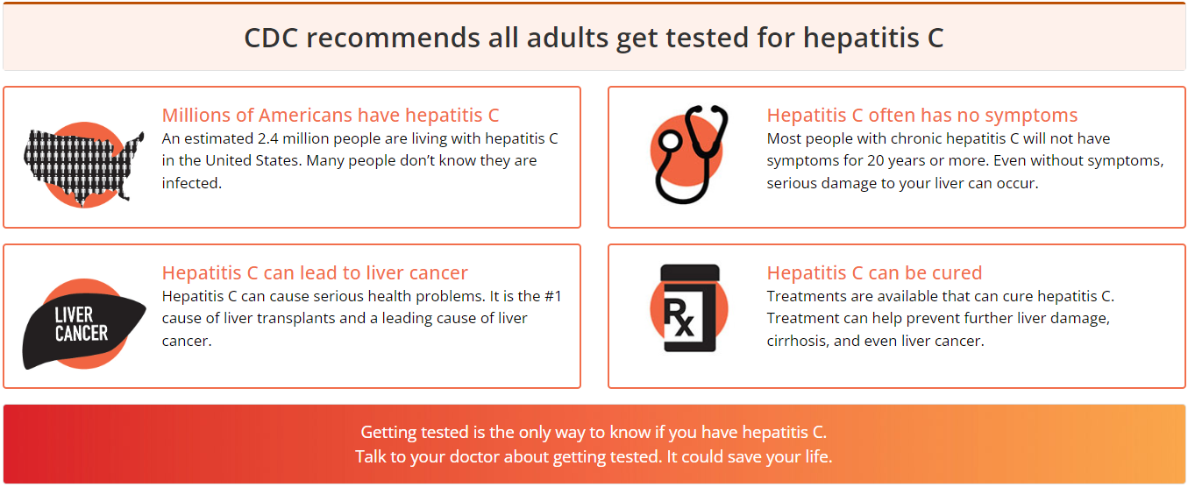
Awareness Campaign – Know More Hepatitis
The CDC launched the Know More Hepatitis to inform people about the risks and reach those who may not be aware of their status.
https://www.cdc.gov/hepatitis-c/public-resources/?CDC_AAref_Val=https://www.cdc.gov/knowmorehepatitis/materials.htm
73
Notes:
Here is a helpful awareness campaign put together by the Centers for Disease Control that provides educational materials for providers, community members and patients. This website has helpful resources you can share in your clinics and communities.

Slide 74
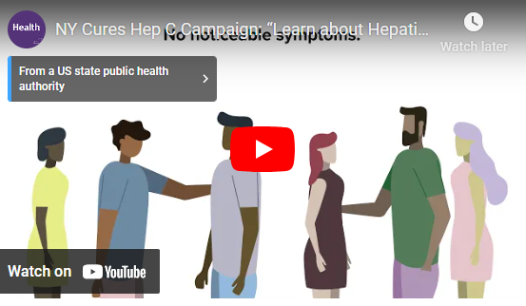

Awareness Campaign - NY Cures Hep C
Source: https://www.health.ny.gov/diseases/communicable/hepatitis/hepatitis_c/nycures/videos_to_share.htm
74
Notes:
Here is another campaign from the New York health authority – NY Cures Hep.
This is an awareness campaign similar to the previous one, but has helpful animated videos that explain the basics of prevention and infection for lay people.
* I’ll show this video if I have time, and if not it is linked in my slides so you can review them later ☺

Slide 75
Thank you!
Beth A. Rutkowski, MPH
brutkowski@mednet.ucla.edu
(310) 388-7647
75

