Slide 1


What is NOCE?
The Nevada Opioid Center of Excellence (NOCE) is dedicated to developing and sharing evidence-based training and offering technical assistance to professionals and community members alike. Whether you’re a care provider or a concerned community member, NOCE provides resources to support those affected by opioid use.
Visit our website at www.nvopioidcoe.org!
Today’s presentation was made possible in whole or in part by the Nevada Department of Health and Human Services (DHHS) Director’s Office through the Fund for a Resilient Nevada, established in Nevada Revised Statutes 433.712 through 433.744. The opinions, findings, conclusions, and recommendations expressed in our courses are those of the author(s) and do not necessarily represent the official views of the Nevada Opioid Center of Excellence or its funders.

Slide 2



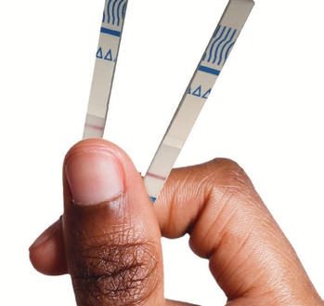


















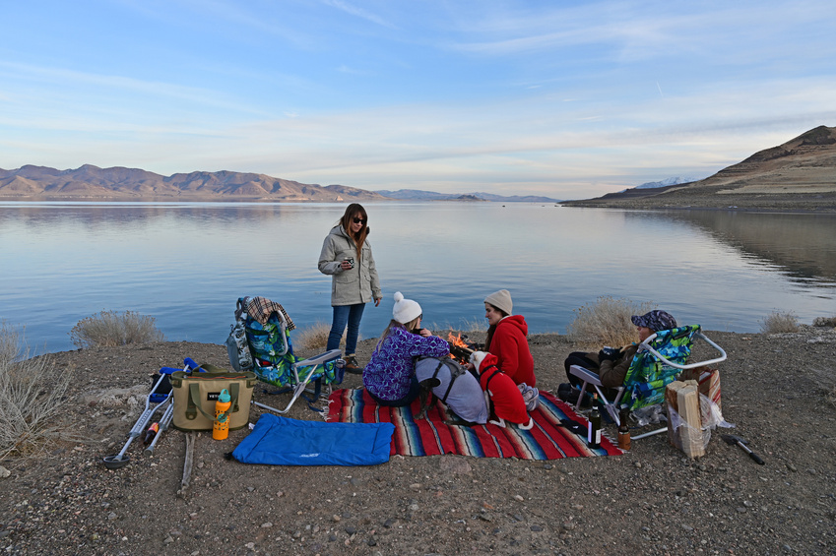

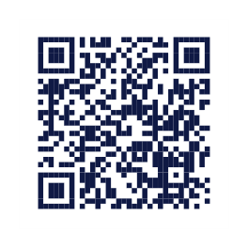


Topics Discussed
The Nevada Opioid Center of Excellence (NOCE) offers free education for everyone in our community - whether you’re a concerned family member, healthcare provider, educator, or community member who wants to make a difference.
Topics include:
Why Participate?
•
How to spot when someone needs help who uses drugs
What to do in an emergency
How to talk to someone who's
upset
Ways to keep loved ones safe from
dangerous medicines
How to properly store and get rid
of medicines
Where to find help in your
community
• • •
All training is completely free
Led by experts in the field
Flexible scheduling options
including in-person and virtual
Interactive, practical learning
experiences
Take-home resources and materials
provided
No experience needed – come
ready to learn
• •
•
•
•
•
•
•
Take action today and request your free session. Together, we can build a safer, healthier Nevada.
Funding for this project was made possible in whole or in part by the Nevada Department of Health and Human Services (DHHS) Director’s Office through the Fund for a Resilient Nevada, established in Nevada Revised Statutes 433.712 through 433.744.

Slide 3


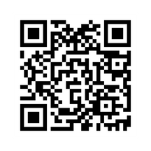








NOCE DOSE
The NOCE Dose: The Opioid Crisis Unplugged is a concise and insightful podcast offering a deeper dive into the realities faced by professionals and champions combating the opioid epidemic within Nevada. Join us as we reconnect with expert panelists from our Listening Sessions, providing a behind-the-scenes look at their work and insights into the pressing issues of prevention and diversion, harm reduction, opioid use treatment, recovery, and reoccurrence prevention.
AVAILABLE ON

Slide 4
Upcoming Events
Upcoming Events
October 28, 2025
October 30, 2025
Preventing Opioid Misuse and Opioid Overdose: Moving Upstream
From Plant to Patient: Clinical Approaches to Kratom Consumption & Addiction
The “all hands on deck” call to address the opioid crisis has challenged our efforts to implement primary prevention that complements other efforts to address the crisis across the spectrum of behavioral health care services. This interactive webinar will explore ways to expand prevention to move our work more upstream–beyond preventing deaths from opioid overdoses to preventing the misuse that leads to those overdoses.
This workshop will provide an in-depth overview of kratom’s pharmacology, patterns of use, and the evolving regulatory landscape. Attendees will gain insight into how kratom differs from traditional opioids, its potential for addiction, and the complexities of withdrawal management. Practical strategies for patient engagement, harm reduction, and evidence-based treatment approaches will be discussed, with a focus on real-world clinical scenarios.

Slide 5

Empowered Pathways Webinar
Starts November 5, 2025
Empowered Pathways:
Addressing Opioid Use Across the Lifespan in Nevada
This comprehensive 4-part webinar series is designed to strengthen Nevada’s approach to opioid and other substance use disorders, with special emphasis on maternal health and family systems. The series provides participants with data, tools, and real-world perspectives to improve prevention, treatment, and recovery supports across the lifespan.
Presented by:
Eboni January, MD, FACOG

Slide 6
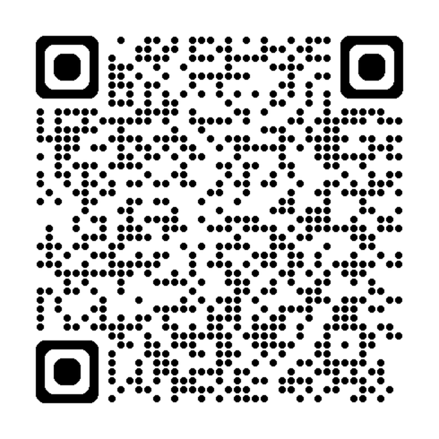
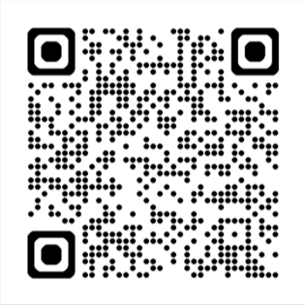
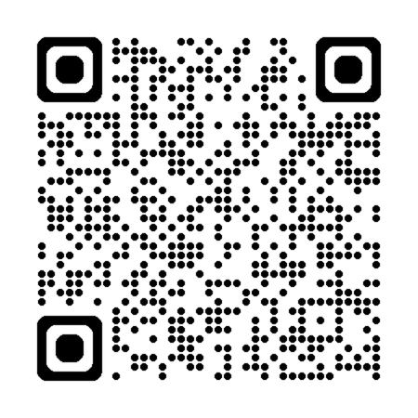
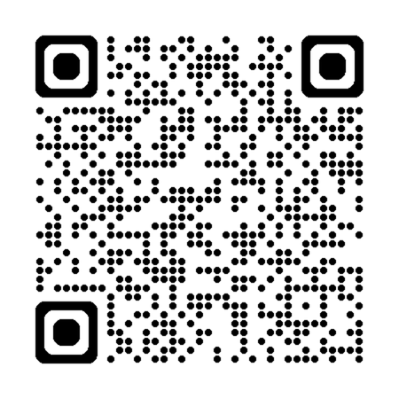
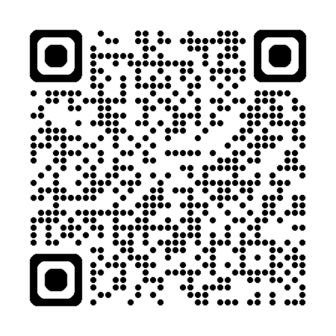

Resources
Anne R. Lindsay, PhD, MS, FACSM
Professor, Extension Specialist
University of Nevada Reno, Extension
Center for the Application of Substance Abuse Technologies (CASAT)
Pacific Southwest Rural Opioid Technical Assistance Region 9 (ROTA-R)
Nutrition and Recovery Webinar
Nutrition and Recovery Fact Sheets
Curriculum Infusion Package (for Academic Courses)
Women and Stimulants Online Learning Course
Healthy Kids Resource Center

Slide 7

Parent/Child Resources in Nevada
Parent/Child Resources in Nevada
Resource
Healthy Start of Southern Nevada | Healthy Start – Southern Nevada Health District | “Healthy Start is a federal program funded through the Health Resources and Services Administrations (HRSA) dedicated to reducing disparities in maternal and infant health status in high-risk communities.”
Baby First Services | Baby First Services - Nevada 211 | “Baby First programs that provide educational and support services for new parents, including healthy eating for the mother, pregnancy, preparation for labor and delivery, breastfeeding, diapering, and basic infant care.”
Babys Bounty – Las Vegas | Program: Babys Bounty-Las Vegas | “Provides baby essentials and vital education to low income families with newborn babies. Also hosts weekly diaper banks where families in need can receive up to a weeks worth of diapers and wipes with a simple registration process. Registration must be done one week prior to distribution.”
Free Parenting Classes | Free Parenting Classes - Catalog and Online Registration | Offers a variety of free classes for parents of babies through teenagers
NV Statewide Maternal and Child Health Coalition (MCH) | Nevada Statewide Maternal and Child Health Coalition - Home | Mission: “To provide leadership in partnership with public and private organizations to improve the physical and mental health, safety, and well-being of the maternal and child health population in Nevada including children with special health care needs.”
Nevada Right to Life | Pregnant and Need Help - Nevada Right to Life | Resources for pregnant women in need
Let Mommy Sleep | Postpartum and Baby Care in the Las Vegas Valley - | Overnight infant care and resources
Subtitle

