Slide 1
Welcome!
The Nevada Opioid Center of Excellence (NOCE) is dedicated to developing and sharing evidence-based training and offering technical assistance to professionals and community members alike. Whether you’re a care provider or a concerned community member, NOCE provides resources to support those affected by opioid use.
Today’s presentation was made possible in whole or in part by the Nevada Department of Health and Human Services (DHHS) Director’s Office through the Fund for a Resilient Nevada, established in Nevada Revised Statutes 433.712 through 433.744. The opinions, findings, conclusions, and recommendations expressed in our courses are those of the author(s) and do not necessarily represent the official views of the Nevada Opioid Center of Excellence or its funders.

Slide 2
Fentanyl and Opioid Use in Behavioral Health: Impacts on Co-Occurring Severe Mental Illness and Treatment Strategies
Mark H. Broadhead, MD
UNRSOM Dept. of Psychiatry
Notes:
Place your title on this first slide and include any subtitle.
DO NOT CHANGE THE FORMAT OF THIS TEMPLATE. If you are creating PSROTA-branded slides, you must use this template. If you move around boxes, make sure to check the reading order. If you widen any boxes they must not overlap any other box.
IF YOU ADD ANY GRAPHICS, you will need to add ALT TEXT and check READING ORDER.
(If the notes on ALT TEXT and READING ORDER do not make sense to you, please let the ATTC National Coordinating Office know to help with remediation.)

Slide 3
Learning Objectives
Analyze the effects of fentanyl and opioid use on individuals with co-occurring severe mental illness (SMI) and how these substances influence overall mental health.
Evaluate the impact of opioid and fentanyl use on the efficacy and management of medications for severe mental illness.
Develop and refine intervention strategies and counseling techniques to address the complexities of treating clients with dual diagnoses involving opioid use and SMI.

Slide 4
Preview of Coming Attractions
Fentanyl Use Disorder Statistics
Fentanyl Characteristics
Unique and Odd Things Fentanyl May Do
Drug Interactions
Effects it may have on other Mental Illnesses

Slide 5
The Good News!
Overdose Deaths are down 12.2%

Slide 6
OVERDOSE DEATH TRENDS

Slide 7
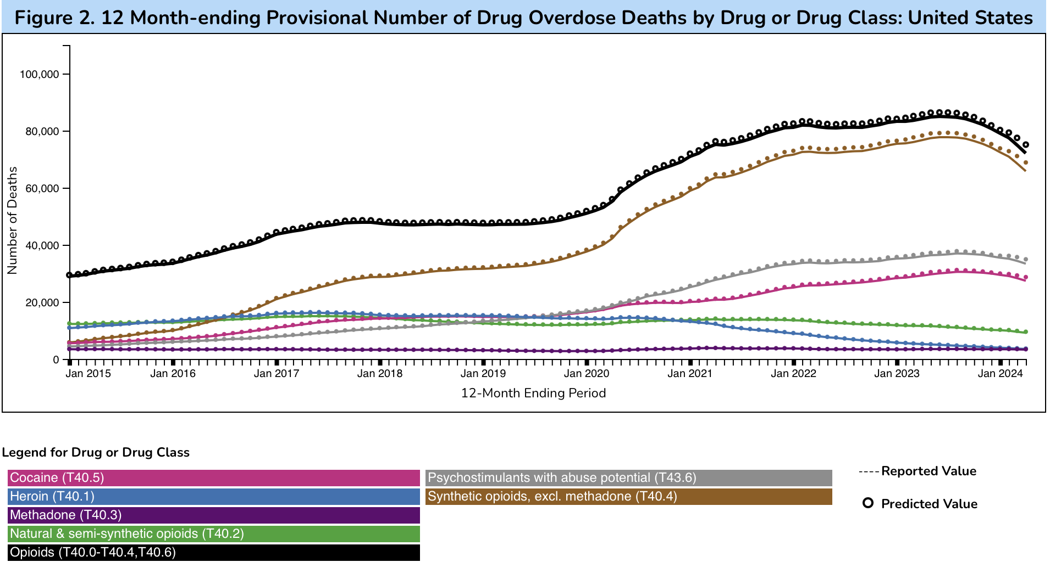
OVERDOSE DEATH TRENDS BY DRUG

Slide 8
The Not So Good News
It is not down around here

Slide 9
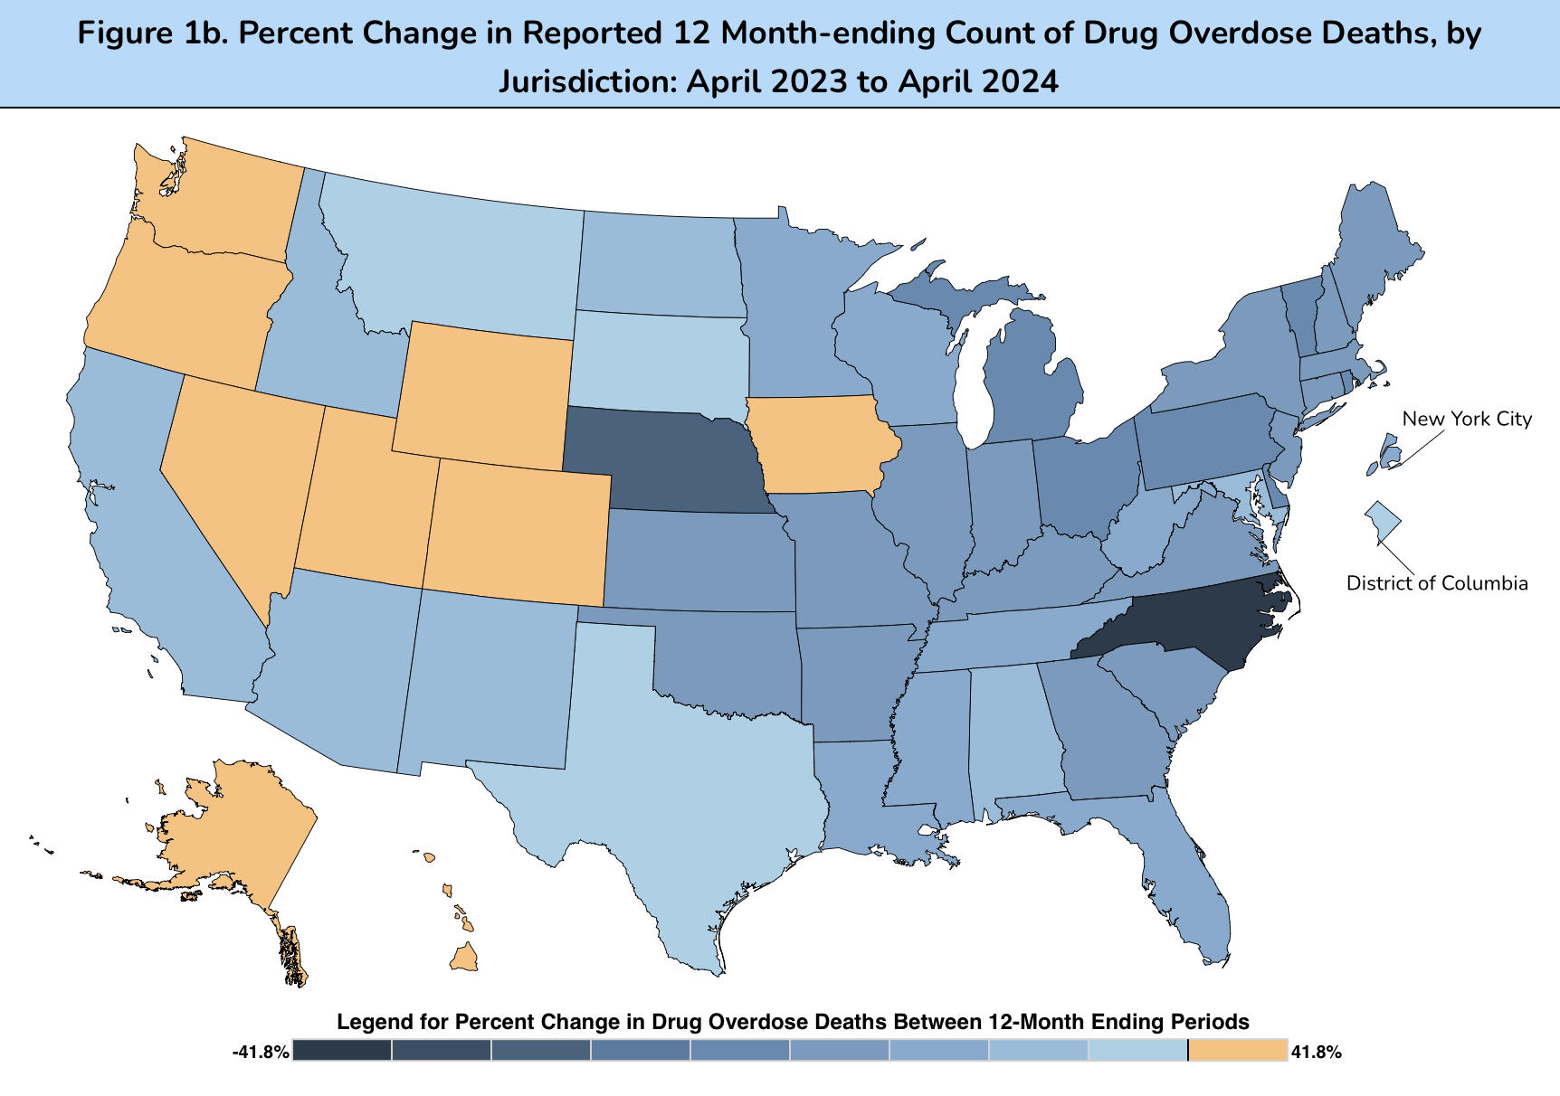
OVERDOSE DEATHS ACROSS THE UNITED STATES

Slide 10
Fentanyl
High Potency Synthetic Opioid (HPSO)
T ½ : 4-7 hours
Onset/Duration: 2-5min/1-4 hours
Metabolized by CYP450 3A4
Moderate P-gp inhibitor
Highly lipophilic

Slide 11
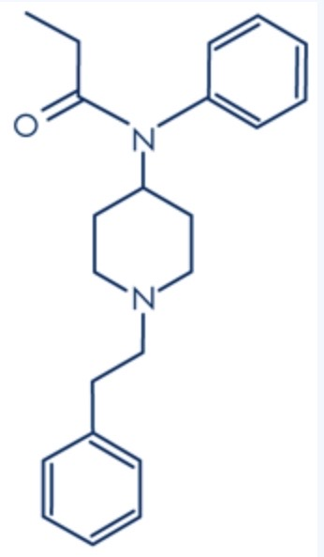
“I Do Love Me a Good Fatty Lover”
While the potency of Fentanyl is 50 times that of other Opioids, Its binding to the receptor in vitro is no better than morphine
The difference between its effects in the test tube and its effects in the body may well be due to its increased love of lipids.

Slide 12
Lipophilic Vs. Hydrophilic Opioid Binding
Hydrophilic binds by 2
Lipophilic binds by 2 and 3.
Notes:
This is a layout for text plus picture. You do not want text or pictures that belong inside the box to exceed the box size. That means you may have to adjust the size of the box or the font size (nothing lower than 12 points). Remember to add alt text to any icon or picture.
There are additional slide layouts available. Select “Layout” from the “Home” tab. (If “Layout” is grayed out, you will need to place your cursor in an open area outside the slide to activate it.)
This is a layout for text plus picture. You do not want text or pictures that belong inside the box to exceed the box size. That means you may have to adjust the size of the box or the font size (nothing lower than 12 points). Remember to add alt text to any icon or picture.
There are additional slide layouts available. Select “Layout” from the “Home” tab. (If “Layout” is grayed out, you will need to place your cursor in an open area outside the slide to activate it.)

Slide 13
The Kama Sutra of Fentanyl

Slide 14
How Fentanyl/HPSO Differ from Heroin/Morphine
PROPERTIES | FENTANYL AND HPSO: DIFFERENCE FROM HEROIN/MORPHINE
Pharmacological Effects (Acute) | Greater "efficacy" than morphine at the MOR (greater ability to activate opioid receptors but similar binding affinity at those receptors.) Fentanyl and HPSO preferentially affect respiratory drive over analgesia resulting in rapid, profound, and prolonged respiratory depression
Pharmacological Effects (Chronic) | High levels of tolerance and physical dependence potentially greater than typical for someone using large amounts of daily heroin Much more variable onset of withdrawal (up to 2-4 days after cessation)
Toxicity/Therapeutic Index | More rapid respiratory suppression Pronounced noradrenergic toxicity (laryngospasm, wooden chest) Higher doses of naloxone appear to be more effective
Pharmacokineticst | Lipid soluble - resulting in faster onset of effect (euphoria and respiratory suppression) but a shorter duration of action as fentanyl and HPSO leave the brain rapidly Fentanyl and HPSO are redistributed to fatty tissues and have prolonged metabolite elimination ½ life (up to 3-4 weeks)
Drug-Taking Behavior | Fentanyl and HPSO are short-acting which may incline users toward more frequent use, putting them at greater risk for overdose, as blood levels may continue to climb with cumulative dosing, and as concentrations increase in fatty tissue
Toxicology Testing | Many commonly used medications cross react with Fentanyl and HPSO on immunoassay screening tests leading to false positives and need to confirm positive screens with more accurate confirmatory tests

Slide 15
Other Drugs Found in Fentanyl Overdoses
GROUP | SUBSTANCE
Anticholinergics | Dicycloverine
Antihistamines | Hidroxycine, Prometazine, Diphenhydramine, Chlorphenyramine, Doxylamine
Anti-inflammatory or Analgesic Drugs | Ibuprofen, Acetaminophen, Salicylic Acid, Naproxen
Antidepressants | Fluoxetine, Mirtazapine, Citalopram, Sertraline, Amitriptyline, Venlafaxine
Antipsychotics | Chlorpromazine, Risperidone, Quetiapine, Olanzapine, Doxepin, Promethazine
Anticonvulsants | Pregabalin, Clonazepam, Gabapentin, Carbamazepine
Barbiturates | Phenobarbital
Benzodiazepines | Diazepam, Alprazolam, Nordiazepam, Chlordiazepoxide, Etizolam, Lorazepam
Stimulants | Ephedrine, Cocaine (Benzoylecgonine), Amphetamine, Nicotine (Cotinine), Mephedrone
Other Opioids | Morphine, Oxycodone, 6-Acetylmorphine, Methadone, Hydrocodone, Meperidine (Pethidine), Tramadol, Propoxyphene, Hydromorphone, Codeine, Buprenorphine, Heroin, Dextrometorphan
Other Drugs of Abuse | Ethanol, Delta-9-Tetrahidrocannabinol, Synthetic Cannabinoids, Ketamine
Other Substances | Levamisole, Lidocaine

Slide 16
Fentanyl and Sudden Cardiac Death
Some of the increased lethality of Fentanyl may be due to the blockade of hERG potassium repolarizing channels in the heart leading to prolonged QT syndrome and sudden death due to cardiac arrythmias.
Several neuroleptic mediations can cause prolonged QT syndrome, often when given in high doses.
Methadone can cause similar QT prolongation.

Slide 17
CYP3A4 Effectors
Inhibitors
Inducers
Strong:
Protease inhibitors
Azole antifungals
Weak:
Non-dihydropyridine calcium-
channel blockers
Macrolides
H2-receptor antagonist
Unspecified potency:
Amiodarone
Quinolones
Selective serotonin reuptake inhibitors
Anticonvulsants
Carbamazepine, Phenytoin
Barbiturates
St. John's wort
Rifampicin
Reverse transcriptase inhibitors
Pioglitazone
Glucocorticoids

Slide 18
Fentanyl and SSRIs
A growing number of cases of Serotonin Syndrome have been reported in people taking SSRIs and Fentanyl
This includes citalopram, escitalopram paroxetine duloxetine and bupropion
Unknown if this is in higher rates than the general population

Slide 19
Criteria for Serotonin Syndrome
Sternbach
Hunter
Must exhibit at least 3 of the 10 following features, with the addition of or increase in a known serotonergic agent:
Must use serotonergic drug, in addition to 1 or more of the following:
Mental status changes
Agitation
Myoclonus
Hyperreflexia
Diaphoresis
Shivering
Tremor
Diarrhea
Incoordination
Fever
Spontaneous clonus
Inducible clonus with agitation or diaphoresis
Ocular clonus with agitation or diaphoresis
Tremor and hyperreflexia
Hypertonia, temperature above 100.4Åã F (38Åã C) with ocular or inducible clonus

Slide 20
Fentanyl and MAOI’s
Opioids have long been known to cause a hypertensive crisis in those who are on MAOIs
The more potent the opioid or the larger the dose, the greater the likelihood of this reaction.
As a result almost all opioids including fentanyl are contraindicated for people on MAOIs.

Slide 21
Fentanyl and Neuroleptics
Neuroleptics that produce sedation can produce an addictive or synergistic effect to Fentanyl’s sedating properties
Fentanyl produces an adrenergic effect in some causing wooden chest syndrome, glottic and supraglottic airway obstruction and general muscle stiffness.
Neuroleptics can cause hypertension in those on fentanyl via an adrenergic response.

Slide 22
Fentanyl’s Effects on SMI
Almost any drug of abuse can have an effect of other MI.
Decrease treatment compliance
Increase psychiatric symptoms (depression, anxiety, psychosis)
Increase psychosocial stressor
Decrease effectiveness of treatment.

Slide 23
Fentanyl isn't just Fentanyl
sufentanil, alfentanil, remifentanil and carfentanil are all pharmaceutically produced analogs of the base chemical fentanyl
Illicitly produced fentanyl has numerous other analogs, many of which have different half lives, metabolic profiles and or unknown properties in humans
There have been over 16 different analogs found in the blood of people who have overdosed

Slide 24
Dosing Protocols
 | Standard | Low-dose | High-dose | Micro-dose with cross taper
Post-agonist washout duration | 16h (short acting) 48h to 72h (long acting) | 24h to 36h | 16h to 24h | No washout Usual dose of agonist continued
First dose of buprenorphine | 2 mg | 0.5 mg to 1 mg | 2 mg to 16 mg | 0.25 mg to 0.5 mg
First day total dose of buprenorphine | 8 mg to 12 mg | 8 mg | 16 mg to 32 mg | 0.5 mg to 1 mg
Adjuntive medications | As needed | Standing doses up to maximum tolerability | As needed | None

Slide 25
Preview of Coming Attractions Pt.2
What constitutes Effective Treatment for SUD?
The Case for Integrated Treatment
Contingency Management and Connectivity

Slide 26
Principles of Effective Treatment
No single Treatment is appropriate for all individuals
Treatment needs to be readily available
Effective Treatment attends to multiple needs of the individual, not just his or her drug use.

Slide 27
Principles of Effective Treatment pt. 2
4. An individual’s treatment and service plan must be assessed continually and modified as necessary to ensure that the plan meets the persons changing needs
5. Remaining in treatment for an adequate period of time is critical for treatment effectiveness.

Slide 28
Principles of Effective Treatment pt. 3
6. Counseling and other behavioral therapies are critical components of effective treatment for addiction.
7. Medications are and important element of treatment for many patients, especially when combined with counseling and other behavioral therapies.

Slide 29
Principles of Effective Treatment pt. 4
8. Addicted or drug abusing individuals with coexisting mental disorders should have both disorder treated in an integrated way.
9. Medical detoxification is only the first stage of addiction treatment and by itself does little to change long-term drug use.
10. Treatment does not need to be voluntary to be effective.

Slide 30
Principles of Effective Treatment pt. 5
11. Possible drug use during treatment must be monitored continuously.
12. Treatment programs should provide assessment for HIV/AIDS, Hep. B and C, TB and other infectious diseases and counseling to help patients modify or change behaviors that place them at risk of infection.

Slide 31
Principles of Effective Treatment pt. 6
13. Recovery from drug addiction can be a long-term process and frequently requires multiple episodes of treatment.

Slide 32
The cat that must be skinned
Topics which need to be addressed in treatment:
Resistance and denial
Relapse prevention and triggers
Cognitive distortions regarding relationships and emotions and self
Increase emotional coping skills
Boundaries, assertiveness and limit setting

Slide 33
The cat that must be skinned pt. 2
Address self esteem issues
Address lifestyle issues
Explore family of origin issues
Emotional/Psychiatric issues
Development of ongoing recovery plan

Slide 34
Treat Both Disorders: Together
The treatment of one disorder is necessary
for the successful treatment of the other
Notes:
Slide source: McLellan, et al: Arch Gen Psychiatry, 40:620, 1983.

Slide 35
Types of therapy used in SUD
CBT
MI and MET
12 Step Facilitation
Harm Reduction Techniques/Education

Slide 36
UCSF Study
120 substance abuse patients with CO psychiatric problems
108 psychiatric patients with CO substance problems
No real difference between the groups
Exception: schizophrenia
Havassy, 2004

Slide 37
Administrative Policy in Treating COC
“ No Wrong Door” Policy
Each provider with the healthcare delivery system has a responsibility to address the range of client needs wherever and whenever a client presents for care (CSAT 2000a)
Notes:
Slide source: McLellan, et al: Arch Gen Psychiatry, 40:620, 1983.

Slide 38
Can therapies for each be combined?
Patients with SUD and PTSD
Pts treated with Prolonged Exposure/CBT (COPE) vs. Relapse Prevention
Similar retention/completion rates
COPE showed superior effect on PTSD.
Both showed significant improvement in SUD
Even RP group showed improvement in PTSD (22%-38%)

Slide 39
Failing to Integrate Treatment
Treatment drop out failure
Slowed progression
Increased rate of relapse
Confusion for patients and families
If one of the co-occurring disorders goes untreated, both usually get worse
Ineffective treatment

Slide 40
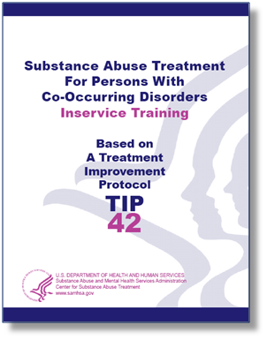
TIP 42: Online PDF
Google TIP 42 for SAMHSA’s manual and Quick Guide
Screening forms
Free Digital Download

Slide 41
Contingency Management Programs
Involve motivational reinforcers to increase compliance
Positive reinforcers = give positive tangible consequences for compliance
Negative reinforcers = withhold negative consequences for compliance

Slide 42
Contingency Management Programs pt. 2
Initially tested in Methadone programs focusing on Methamphetamine.
Focus was on Voucher Systems
Did not necessarily increase efficacy of treatment, but helped effectiveness by increasing retention.

Slide 43
Medication compliance - Baseline

Slide 44
Impact of fentanyl on retention

Slide 45
OTIS Medication Compliance

Slide 46
OTIS Retention at 6-months

Slide 47
Who Are They and What Did They Do?
The Life Change Center
Washoe County Community Reinvestment
UNR School of Public Health
Opioid Treatment Induction Support
OTIS

Slide 48
The Guts of OTIS
Patients meet their OTIS Team on their first day. The OTIS team members contact the patient by phone after they leave the clinic:
Peer Recovery Support Specialist – daily for the first 28 days
– 3X weekly for the second 28 days
– 1X weekly for the third/last 28 days
Nurse – 3X weekly for the first 28 days
– 3X weekly for the second 28 days
– 1X weekly for the third/last 28 days
Patients are given incentives if they answer their phone at least 5X per week during the first and second 28-day periods.
Incentives of $10 gift cards were awarded weekly.
In addition to the phone calls, on the day of their intake the OTIS participant:
Introduced to the members of their OTIS Team
Given clear explanation on how the program works. Explanation of the incentives and phone calls
Given support to access a phone if needed

Slide 49
OTIS Research Methodology
Inclusion Criteria:
Exclusion Criteria:
Voluntary
Fentanyl positive
If readmission, at least three-month break in treatment
Data collection:
Jan 3rd – June 27th, 2023
All intakes meeting inclusion criteria
Broken into two categories
Completed (N=102)
All (N=205)
Not answering OTIS calls
10 consecutive days (first 28 days)
7 consecutive attempts (2nd and 3rd 28-day periods)
Considered “did not complete” (DNC)
Patient exclusion from OTIS had no bearing on exclusion from MOUD program.
Did not complete (N=103)
All (N=205)

Slide 50
OTIS Calls
Peer Recovery Support Specialist
NURSE CALLS:
Supportive and nonjudgmental tone
Encouragement for returning the next day for medication
Share ideas for managing withdrawal symptoms
Share ideas for maximizing value of SUD counseling and other wrap around services offered at the treatment setting
Supportive and nonjudgmental tone
Help patient understand their withdrawal symptoms
Guide patient in understanding the medication portion of their treatment
Encouragement for returning the next day for medication

Slide 51
Don’t Underestimate Connectivity
It is a critical factor in our mental health and social fabric
It is at the heart of all of our psychotherapeutic interventions
It is the essence of all mutual support organizations
It is the reason Peer Support specialists can be so powerful
Nobody Cares How Much You Know Until they Know How Much You Care

Slide 52
Questions?

